Slide 1
4-Analysis of Variance (ANOVA)
Comparing means

Slide 2
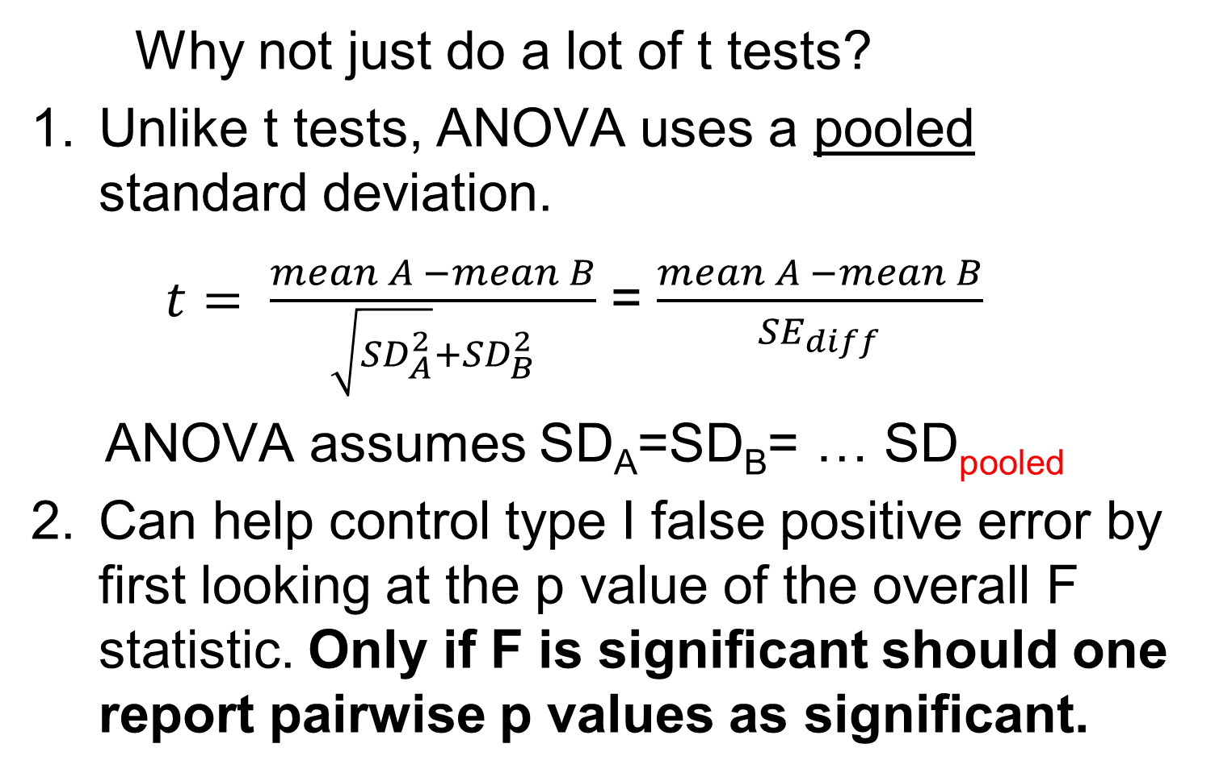
Comparing means-ANOVA
Why not just do a lot of t tests?
Unlike t tests, ANOVA uses a pooled standard deviation.
$t= \frac{mean A −mean B}{\sqrt{{SD}_{A}^{2}}+{SD}_{B}^{2}}$ = $\frac{mean A −mean B}{{SE}_{diff}}$
ANOVA assumes SD_{A}=SD_{B}= … SD_{pooled}
Can help control type I false positive error by first looking at the p value of the overall F statistic. Only if F is significant should one report pairwise p values as significant.

Slide 3

Fundamentals- comparing means

Slide 4
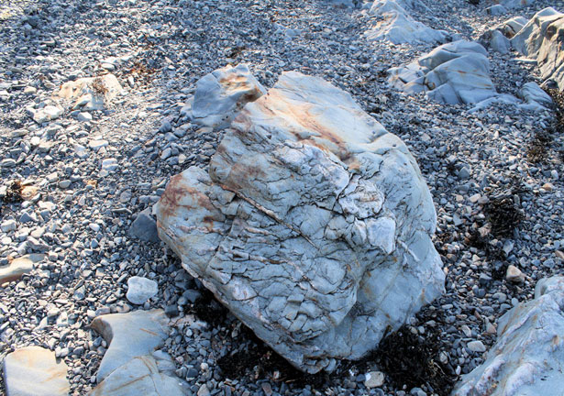
The “Yardstick” is critical

Slide 5
The “Yardstick” is critical
yardstick: _________ 1 µm

Slide 6
The “Yardstick” is critical
yardstick: _________ 10 meters

Slide 7
Weight loss comparison
Diet mean weight loss (lbs) n
Pritikin 5.0 20
UCLA GS 9.0 20
mean difference 4.0
Is 4.0 lbs a “big” difference?
Compared to what? What is the “yardstick”?

Slide 8
The variation yardstick
SD = 1 lb, SE_{diff}=0.32 , t=12.6, p value < 0.0001

Slide 9
The variation yardstick
SD = 5 lbs , SE_{diff}=1.58, t= 2.5, p value = 0.02

Slide 10
The SD is the yardstick
It is important that the SD, the “yardstick”, be as accurate as possible so it should be based on as much data as possible. If the “yardstick” is not correct, conclusions about which means are different from each other will not be correct.

Slide 11
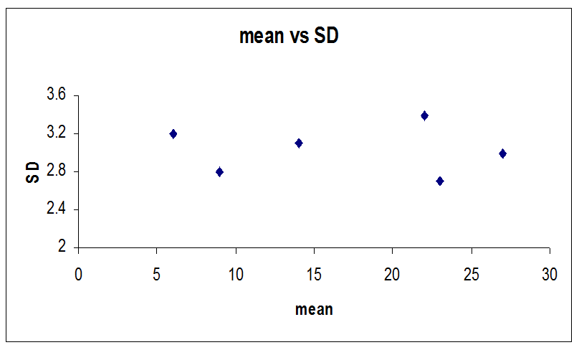
Variance (SD) homogeneity assumed true for usual ANOVA, SDs are pooled

Slide 12
For ANOVA- Pooled SD_{e} the common yardstick
SD²_{pooled error} = SD²_{e} =
(n₁-1) SD₁² + (n₂-1) SD₂² + … (n_{k}-1) SD_{k}²
(n₁-1) + (n₂-1) + … (n_{k}-1)
____
so, SD_{e} = = √ SD²_{e}

Slide 13
t test vs ANOVA – not the same
If there are many groups (A,B,C…) one might compute p values for each comparison via a series of t tests.
group mean n SD SEM
A 20 16 17.0 4.25
B 30 16 14.0 3.50
  C 40 16 12.0 3.00
  Pooled SD = 14.5, pooled SEM=3.63

Slide 14
t tests vs ANOVA (cont.)
If we use t tests, we can find that two comparisons with the same mean difference and sample sizes have different p values!
n=16 per group
Comparison mean diff SE_{d} t p value
A vs B 10.0 5.51 1.82 0.091
B vs C 10.0 4.61 2.17 0.048
This is because the “yardstick”, the SD, is changing, so SE_{d} = √SD₁²/n₁+SD₂²/n₂
is changing even if n is not.

Slide 15
t tests vs ANOVA (cont.)
If one uses the pooled SD, one gets consistent p values for the same mean difference
Pooled SD=14.5, SE_{d}=5.12, n=16 per group
Comparison mean diff SE_{d} t p value
A vs B 10.0 5.12 1.95 0.060
B vs C 10.0 5.12 1.95 0.060
The SE_{d} and t values are all computed using the same SD “yardstick”.

Slide 16
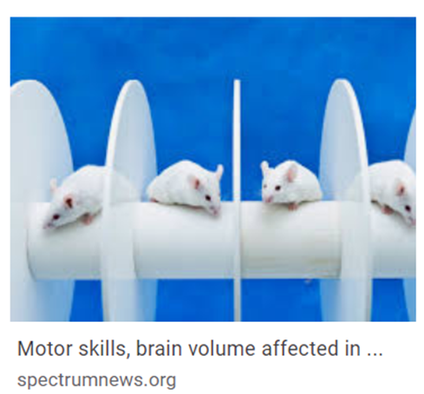
TBI expt-time to fall off rotating rod

Slide 17
Means & SDs in seconds
No model
Level | Number | Mean | median | SD | SEM
KO-no TBI | 8 | 21.196 | 21.65 | 6.46 | 2.28
KO-TBI | 7 | 18.659 | 18.47 | 8.73 | 3.30
WT-noTBI | 15 | 49.197 | 46.93 | 9.92 | 2.56
WT-TBI | 21 | 23.902 | 23.33 | 13.31 | 2.90
ANOVA model, pooled SDe=10.986 sec
Level | Number | _{Mean} | SEM
KO-no TBI | 8 | _{21.196} | 3.88
KO-TBI | 7 | _{18.659} | 4.15
WT-noTBI | 15 | _{49.197} | 2.84
WT-TBI | 21 | _{23.902} | 2.40
SEM= SD/√n. Why are no model vs model SEMs not the same?

Slide 18
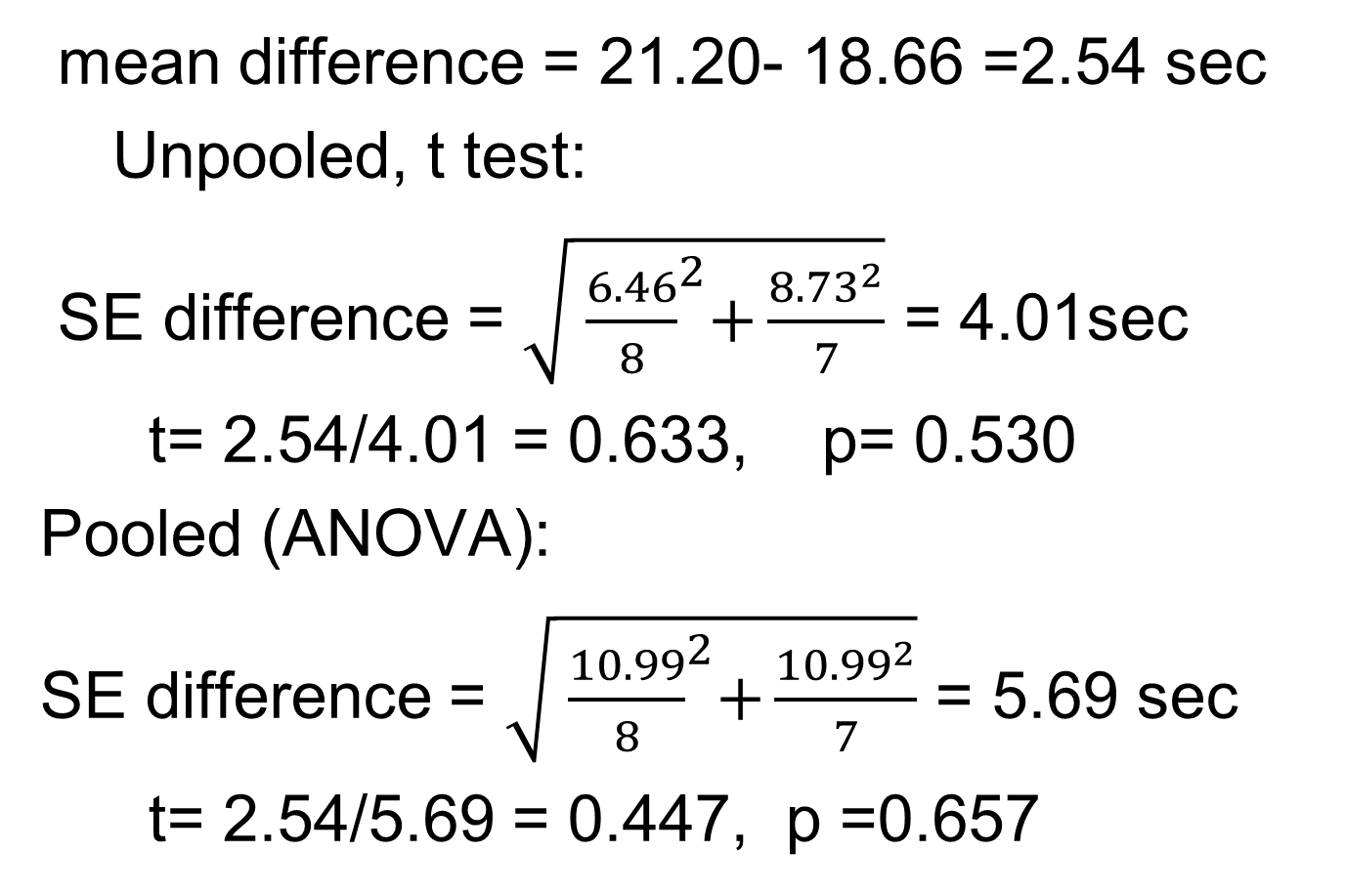
Example: KO-no TBI vs KO-TBI
mean difference = 21.20- 18.66 =2.54 sec
Unpooled, t test:
SE difference = $\sqrt{{ \frac{6.46}{8}}^{2}+\frac{{8.73}^{2}}{7}}$ = 4.01sec
t= 2.54/4.01 = 0.633, p= 0.530
Pooled (ANOVA):
SE difference = $\sqrt{{ \frac{10.99}{8}}^{2}+\frac{{10.99}^{2}}{7}}$ = 5.69 sec
t= 2.54/5.69 = 0.447, p =0.657

Slide 19
Multiplicity & F tests
Multiple testing can create “false positives”. We incorrectly declare means are “significantly” different as an artifact of doing many tests even if none of the means are truly different from each other.
Imagine we have k=four groups: A, B, C and D.
There are m=six possible mean comparisons:
A vs B
A vs C
A vs D
B vs C
B vs D
C vs D

Slide 20
If we use p < 0.05 as our “significance” criterion, we have a 5% chance of a “false positive” mistake for any one of the m=six comparisons, assuming that none of the groups are really different from each other. We have a 95% chance of no false positives if none of the groups are really different. So, the chance of a “false positive” in any of the six comparisons is
1 – (0.95)⁶ = 0.26 or 26%.

Slide 21
Overall F screening test
To guard against too many false positives, first compute the “overall” F statistic and its p value.
F = [variation across means/ SD_{pooled}]²
If “overall” p > 0.05, we stop. Only if the overall p < 0.05 will the pairwise post hoc (post overall) t tests and p values have no more than an overall 5% chance of a “false positive”.

Slide 22
One way analysis of variance time to fall data, k= 4 groups, df= k-1=3
R square | 0.5798
Adj R square | 0.5530
Root Mean Square Error=SD_{e} | 10.99
Mean of Response | 30.20
Observations (or Sum Wgts) | 51
F= between group variation
within group variation
p value
Source | DF | Sum of Squares | Mean Square | F Ratio | Prob > F
group | 3 | 7827.438 | 2609.15 | 21.618 | <.0001
Error | 47 | 5672.546 | 120.69
Total | 50 | 13499.984
Pooled SD
Only declare any mean comparison significant if overall F is significant

Slide 23
Post hoc: t vs Tukey q, k=4
Level | vs Level | Mean Diff | SE diff | t | p-Value- no correction | p-Value-Tukey
WT-noTBI | KO-TBI | 30.54 | 5.03 | 6.073 | <.0001* | <.0001*
WT-noTBI | KO-no TBI | 28.00 | 4.81 | 5.822 | <.0001* | <.0001*
WT-noTBI | WT-TBI | 25.30 | 3.71 | 6.811 | <.0001* | <.0001*
WT-TBI | KO-TBI | 5.24 | 4.79 | 1.094 | 0.2797 | 0.6952
WT-TBI | KO-no TBI | 2.71 | 4.56 | 0.593 | 0.5562 | 0.9338
KO-no TBI | KO-TBI | 2.54 | 5.69 | 0.446 | 0.6574 | 0.9700

Slide 24
When to do non parametric tests
One should report medians and the interquartile range (Q1,Q3) instead of means and SDs for continuous Y when Y does not follow a normal distribution. If Y does not follow a normal distribution, the mean Y and median Y will NOT be similar. If Y follows the normal, mean-2SD, mean + 2SD should roughly be the range of the data.
If data is nonparametric, get p values from Wilcoxon rank-sum or Kruskal-Wallis test (non parametric ANOVA).

Slide 25
Does data follow a Gaussian distribution?
(Yoon et. al., Sleep Medicine, 2019).
ESS=Epworth Sleep Scale, NOSE=Nasal Obstruction Symptom
AHI= apnea-hypopnea index=# apneas/hr
ODI=Oxygen Desaturation Index
 | Pre-op mean ± SD | Post-op mean ± SD | p value
ESS | 10.48 ± 5.40 | 6.69 ± 4.75 | < 0.0001
NOSE | 10.94 ± 5.51 | 3.28 ± 2.89 | < 0.0001
AHI | 17.65 ± 19.30 | 8.17 ± 8.47 | < 0.0001
ODI | 13.16 ± 18.46 | 5.14 ± 5.90 | 0.0051
How do we know ODI does not follow a normal distribution? (Hint: ODI > 0)

Slide 26
Example: Estradiol=E2 (pg/mL)
(menstruating females)
Mean 136
SD 100
Median 110
Q1 70
Q3 171
mean not close to median
mean – 2 SD = 136 – 2(100)= -64
(However, log E2 has a normal distribution).

Slide 27
5-correlation and regression

Slide 28
Ex: Riddle, J. of Perinatology (2006) 26, 556–561
50th percentile for birth weight (BW) in g
as a function of gestational age
Birth Wt (g) =42 exp(0.1155 gest age)
or
Log_{e}(BW) = 3.74 + 0.1155 gest age
In general: BW = A exp(B gest age), A & B change for different percentiles
log(BW) = C + B gest age where C=log(A)

Slide 29
Simple Linear Regression statistics
Statistics for the association between a continuous X and a continuous Y.
A linear relation is given by an equation
Y = a + b X + errors (errors=e=Y-Ŷ)
Ŷ = predicted Y = a + b X
a = intercept, b =slope= rate of change
r = correlation coefficient, R²=r²
R²= proportion of Y’s variation due to X
SD_{e}=residual SD=RMSE=√mean square error

Slide 30
Ex: X=age (yrs) vs Y=SBP (mmHg)
SBP = 81.5 + 1.22 age + error
SD_{e} = 18.6 mm Hg, r = 0.718, R² = 0.515

Slide 31
“Residual” error
residual error = e = Y – Ŷ
The “residual error” is the difference between the actual observed value Y and the model (equation) predicted value, Ŷ.
The sum and mean of the e_{i}’s will always be zero. The residual error standard deviation, SD_{e}, is a measure of how close the observed Y values are to their equation predicted values (Ŷ). When r=R²=1, SD_{e}=0.

Slide 32
age vs SBP in women - Predicted SBP (mmHg) = 81.5 + 1.22 age, r=0.72, R²=0.515
Patient | X | Y | Predicted=Ŷ | error=e |  | Patient | X | Y | Predicted=Ŷ | error=e
1 | 22 | 131 | 108.41 | 22.59 |  | 17 | 49 | 133 | 141.41 | -8.41
2 | 23 | 128 | 109.63 | 18.37 |  | 18 | 49 | 128 | 141.41 | -13.41
3 | 24 | 116 | 110.85 | 5.15 |  | 19 | 50 | 183 | 142.64 | 40.36
4 | 27 | 106 | 114.52 | -8.52 |  | 20 | 51 | 130 | 143.86 | -13.86
5 | 28 | 114 | 115.74 | -1.74 |  | 21 | 51 | 133 | 143.86 | -10.86
6 | 29 | 123 | 116.97 | 6.03 |  | 22 | 51 | 144 | 143.86 | 0.14
7 | 30 | 117 | 118.19 | -1.19 |  | 23 | 52 | 128 | 145.08 | -17.08
8 | 32 | 122 | 120.63 | 1.37 |  | 24 | 54 | 105 | 147.53 | -42.53
9 | 33 | 99 | 121.86 | -22.86 |  | 25 | 56 | 145 | 149.97 | -4.97
10 | 35 | 121 | 124.30 | -3.30 |  | 26 | 57 | 141 | 151.19 | -10.19
11 | 40 | 147 | 130.41 | 16.59 |  | 27 | 58 | 153 | 152.42 | 0.58
12 | 41 | 139 | 131.64 | 7.36 |  | 28 | 59 | 157 | 153.64 | 3.36
13 | 41 | 171 | 131.64 | 39.36 |  | 29 | 63 | 155 | 158.53 | -3.53
14 | 46 | 137 | 137.75 | -0.75 |  | 30 | 67 | 176 | 163.42 | 12.58
15 | 47 | 111 | 138.97 | -27.97 |  | 31 | 71 | 172 | 168.31 | 3.69
16 | 48 | 115 | 140.19 | -25.19 |  | 32 | 77 | 178 | 175.64 | 2.36
 |  |  |  |  |  | 33 | 81 | 217 | 180.53 | 36.47
 | X | Y | Predicted | error
Mean | 46.7 | 138.6 | 138.6 | 0.0
SD | 15.5 | 26.4 | 18.9 | 18.6
Mean error is always zero

Slide 33
Confidence intervals (CI)
Prediction intervals (PI)
Model: predicted SBP=Ŷ=81.5 + 1.22 age
For age=50, Ŷ=81.5+1.22(50) = 142.6 mm Hg
95% CI: Ŷ ± 2 SEM, 95% PI: Ŷ ± 2 SD_{e}
SEM=3.3 mm Hg ↔ 95% CI is (136.0, 149.2)
SD_{e}=18.6 mm Hg ↔ 95% PI (104.8,180.4)
The Ŷ=142.6 is predicted mean for all age 50 and the predicted value for one individual age 50. Both interpretations are correct.

Slide 34
R squared statistic measure of model accuracy
SD_{y}² = “all” the variation in Y
SD_{e}² = the variation NOT accounted for by X (more generally, not accounted for by Xs)
SD_{y}² – SD_{e}² = the variation that IS accounted for by X (or all the Xs)
R²=(SD_{y}² – SD_{e}²)/ SD_{y}² = proportion of total variation “accounted for” by Xs.

Slide 35
How big should R² be?
SBP SD = 26.4 mm Hg, SD_{e}=18.6
95% PI: Ŷ± 2(18.6) or Ŷ± 37.2 mm Hg
How big does R² have to be to make
95% PI: Ŷ ± 10 mm Hg? → SD_{e}≈ 5 mm Hg
R²=1-(SD_{e}/SD_{y})²=
1-(5/26.4)² = 1-0.036=0.964 or 96.4%
(with age only, R² = 0.515)

Slide 36
Correlation coefficient (r)
Instead of regressing Y on X,
create Y_{s} = (Y-mean Y)/SD_{y} =“standardized Y”
X_{s} = (X-mean X)/SD_{x} =“standardized X”
Y_{s} & X_{s} are both in SD units & have mean=0
If regress Y_{s} on X_{s}: Y_{s} = a + b X_{s} + error
a is always 0. “b” is called “r”, the correlation coefficient, the “slope” in SD units.
r ranges from -1 to 1. r stays the same if the roles of Y_{s} and X_{s} are reversed. A value of r=0 implies no (linear) association between X and Y.

Slide 37
Correlation-interpretation, |r| < 1

Slide 38
Slope is related to correlation
(simple regression)
slope = correlation x (SD_{y}/SD_{x})
b = r (SD_{y}/SD_{x}) b=1.22=0.7178(26.4/15.5)
where SD_{y} is the SD of the Y variable
SD_{x} is the SD of the X variable
r = b (SD_{x}/SD_{y}) 0.7178=1.22(15.5/26.4)
r = b SD_{x}/√ b² SD_{x}² + SD_{e}²
SD_{e} = residual error SD, SD_{x} = SD of X
when b=0, r=0, when b>0, r>0, when b<0, r<0

Slide 39
Pearson vs Spearman corr=r
Pearson r – Assumes relationship between Y and X is linear except for noise.
“parametric” (inspired by bivariate normal model). Strongly affected by outliers.
Spearman r_{s} – Based on ranks of Y and X. Assume relation between Y and X is monotone (non increasing, non decreasing). “Non parametric”. Less affected by outliers.

Slide 40
Pearson r vs Spearman r_{s}
r =0.25, r_{s} = 0.48

Slide 41
Pearson r vs Spearman r_{s}
r =0.25, r_{s} = 0.48

Slide 42
Limitation of linear models

Slide 43
Limits to linear regression – “Pathological” Behavior
Ŷ = 3 + 0.5 X, r = 0.817, SDe = 13.75, n=11
(for all four datasets below)
Weisberg, Applied Linear Regression, p 108

Slide 44
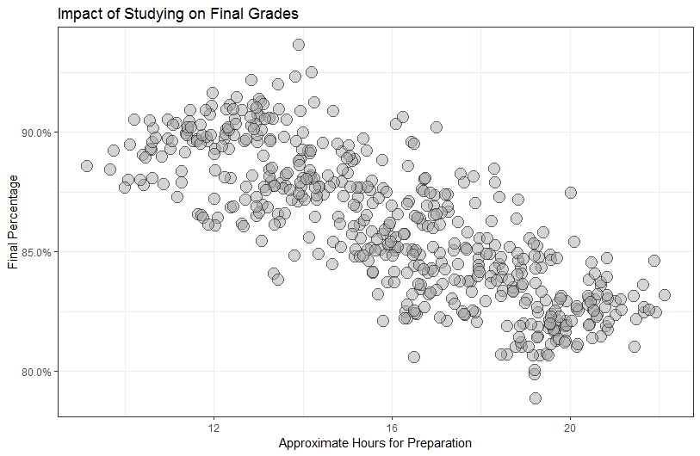
Simpson’s paradox
Final grade (Y) vs hours studying (X), r = -0.7981 – negative relationship ?

Slide 45
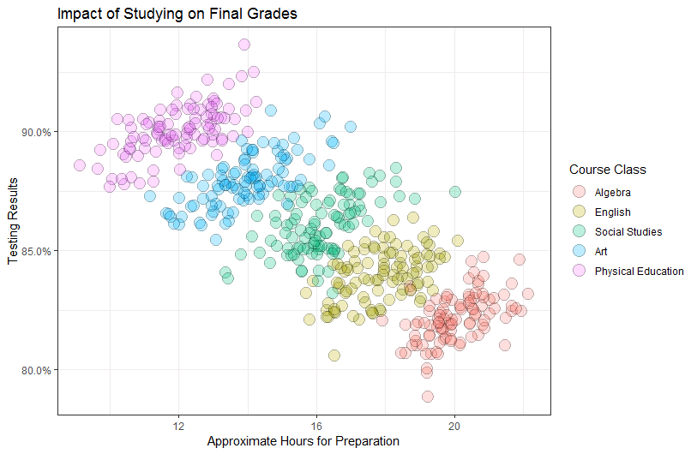
Simpson’s paradox (cont.)
Controlling for type of course – relations are now positive

Slide 46
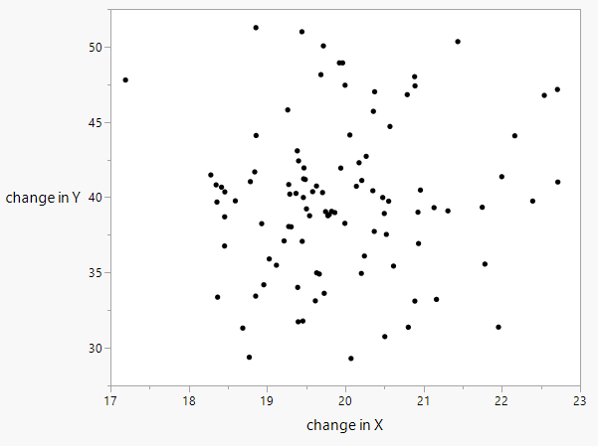
Mean changes do not imply correlation
Just because there is a positive mean X change and a positive mean Y change does not necessarily imply that X and Y are correlated.
mean X change =19.9, mean Y change=39.9
r=0
Notes:
Mean Kids height got larger, Mean kids IQ got larger – not correlated

Slide 47
Check –Linearity, (restricted) cubic spline
Generally use restricted cubic splines with 3-5 knots to check linearity

Slide 48
Check linearity - ANDRO by BMI assume linear, R²=0.153 assume spline, R²=0.165 p value = 0.8130 (LR test, null is linear)
Linear
Spline

Slide 49
Overview of Multiple regression
One outcome, many predictors

Slide 50
Supervised Machine Learning
•“White box” models - interpretable:
regression, analysis of variance
•“Gray (almost black) box” models:
Random forests, Boosting, Support vector
machines, K nearest neighbor …
•”Black box” models:
Neural Nets, …
Prefer “white box” models since they are more easily interpretable and easier to replicate even if they don’t always make the most accurate predictors.

Slide 51
Multiple Regressions are equations
Multiple Regression in statistics is the science and art of creating an equation that relates a continuous outcome “Y”, to one or more predictors, X₁, X₂, X₃, .. X_{k}.
“Y” = b₀ + b₁X₁ + b₂ X₂ + b₃ X₃ + ... + b_{k} X_{k}
“Y” can be:
continuous value – Linear regression (get mean Y)
log(P/(1-P)) = logit(P) – logistic regression
P is the proportion of Ys that are positive, Y is 1 or 0
log (counts) – Poisson regression , Y is 0,1,2,3, ….
log(hazard)=log(events/time) – Cox regression

Slide 52
“Regressions-generalized linear model”
Outcome (Y) | “link= g(Y)” | Regression
Continuous | Identity- g(Y)=Y | Linear
Continuous | Identity | ANOVA, all Xs discrete
Binary (yes/no) | Logit =log(P/(1-P)) | Logistic
Ordered categories | Cumulative logit | Ordinal logistic
Counts (0,1,2,…) | log(Y) | Poisson
Hazard rate=h = “Y” | log(h) | Cox

Slide 53
Regression coefficient (b) interpretation
Outcome (Y) | Regression | interpretation
continuous | Linear | b is the average change in Y per one unit increase in X, the rate of change b is a mean difference if X is categorical
binary (P=proportion) | Logistic | exp(b)=e^{b}=odds ratio (OR) for a one unit increase in X
low Positive integers (0,1,2,3..) | Poisson | exp(b)= mean ratio (MR) for a one unit increase in X
Hazard rate (h=hazard= events/time) | Cox | exp(b)=hazard rate ratio (HR) for a one unit increase in X S(t) = S₀(t)^{HR}

Slide 54
Known confounders should be almost always be included in the regression equation whether they are significant or not.
Example: When determining if fertility drug dose is related to proportion who get pregnant, must include age, even if the p value for age is p=0.17.

Slide 55
Linear -Predictors of Y=SBP in children
Gilman et. al. JAMA, v 267, no 17, May 1992
Predicted SBP= -9.20 -2.27 Ca + 4.03 sex + 0.25 Ht + 2.02 BMI + 0.51 HR

Slide 56
Logistic regression
Predictors of in hospital infection
Characteristic Odds Ratio (95% CI) p value
Incr APACHE score 1.15 (1.11-1.18) <.001
Transfusion (y/n) 4.15 (2.46-6.99) <.001
Increasing age (yr) 1.03 (1.02-1.05) <.001
Malignancy 2.60 (1.62-4.17) <.001
Max Temperature 0.70 (0.58-0.85) <.001
Adm to treat>7 d 1.66 (1.05-2.61) 0.03
Female (y/n) 1.32 (0.90-1.94) 0.16
*APACHE = Acute Physiology & Chronic Health Evaluation Score

Slide 57
Chung Overall survival (“at mean”)

Slide 58
Breast Cancer recur/death
(Chung) n=86 of 95, 23 failures, C=0.84
Predictor | b | SE(b) | Haz Rate Ratio | Lower CL | Upper CL | p value
Pre-Menopausal (vs post) | 0.750 | 0.552 | 2.12 | 0.72 | 6.25 | 0.1853
Positive nodes (yes or no) | 1.29 | 0.52 | 3.63 | 1.29 | 10.28 | 0.0152
Stage 2 vs 1 | 2.12 | 0.70 | 8.30 | 2.11 | 32.59 | 0.0007
Stage 3 vs 1 | 0.98 | 0.95 | 2.67 | 0.42 | 17.07 | 0.3063
Stage 4 vs 1 | 3.85 | 0.91 | 46.83 | 7.94 | 276.3 | < 0.001
Positive tumor margin | 1.15 | 0.51 | 3.14 | 1.15 | 8.59 | 0.0350
Neoadjuvant chemo | -1.61 | 0.84 | 0.20 | 0.04 | 1.04 | 0.0483

Slide 59
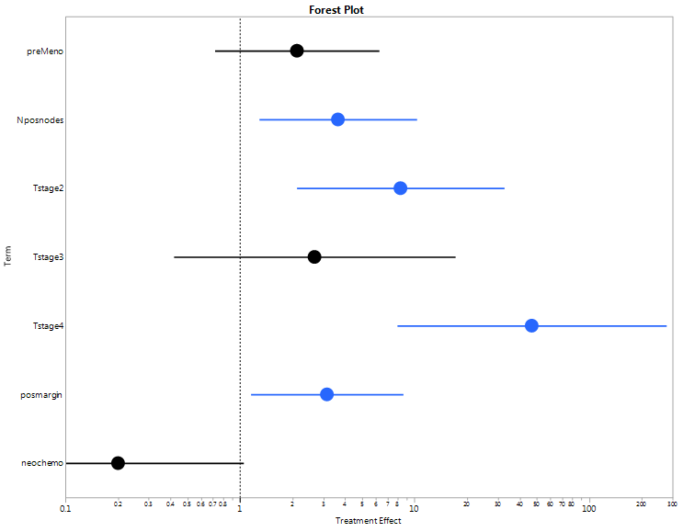
Forest plot- Chung model

Slide 60
Cox model calculator demo here.

