Slide 1
3-Hypothesis testing & p values, confidence intervals, power

Slide 2
Sampling distribution: SD ≠ SE
BMI has a distribution across patients
standard deviation, SD, measures patient variation
Mean BMI, a statistic, has a sampling distribution across studies, standard error, SE, measures variation of the statistic from study to study, SE=SD/√n

Slide 3
Any statistic “$\hat{θ}$” has a sampling distribution and therefore a standard error (SE).
1. SE gets smaller as $\sqrt{n}$ gets larger. If want to halve the SE, need to increase n 4 fold.
2. On average, as n gets larger, the sample $\hat{θ}$ gets closer to the true population value,θ.
3. For large n, $\hat{θ}$ follows the normal distribution centered on θ. For small n, the distribution may not be normal (need “non parametric” methods)

Slide 4
Some sample statistics & their SEs
Sample Statistic Symbol Standard error (SE)
Mean y̅ S/√n = √[S²/n] = SEM
Mean difference y̅₁ – y̅₂ = d̅ √[S₁²/n₁ + S₂²/n₂]= SE_{d}
Proportion P √[P(1-P)/n]
Proportion difference P₁ – P₂ √[P₁(1-P₁)/n₁ + P₂(1-P₂)/n₂]
Log Odds ratio* log_{e}OR √[ 1/a + 1/b + 1/c + 1/d]
Log Risk ratio* log_{e}RR √[1/a -1/(a+c) + 1/b - 1/(b+d)]
Slope (rate) b S_{error} / S_{x}√(n-1)
Hazard rate (survival) h h/√[number events]
Transform (z) of the
Correlation coefficient r* z=½log_{e}[(1+r)/(1-r)] SE(z)=1/√([n-3])
r = (e^{2z} -1)/(e^{2z} + 1)
Log Hazard Ratio* log_{e} HR √[(1/e₁) + (1/e₂)]
(assumes constant h) (e₁ & e₂ are number of events)
*form CI bounds on log scale, then take anti-log
2 x 2 table
a | b
c | d

Slide 5
Confidence interval (for θ)
Do not know true population θ from a sample.
For a sample statistic $\hat{θ}$ and standard error SE, a confidence interval for the true population value θ is formed by
$\hat{θ}$ - Z SE, $\hat{θ}$ + Z SE
(sample statistic is in the middle)
For a 95% confidence interval, we use Z=1.96 and compute
$\hat{θ}$– 1.96 SE, $\hat{θ}$ + 1.96 SE
lower
upper

Slide 6
Confidence Intervals (CI) and sampling dist of $\hat{θ}$
$\hat{θ}$-1.96 SE θ $\hat{θ}$+1.96 SE
95% CI: $\hat{θ}$ ± 1.96 SE

Slide 7
95% Confidence intervals
95% of the intervals will contain the true population value
But which ones?

Slide 8
Funnel plot - true difference is δ= 5 Each point is one study (meta analysis)

Slide 9
Hypothesis test statistic in Z units sampling distribution-null value is 0 Z_{obs} = ($\hat{θ}$ – null value) / SE

Slide 10
What are p values?
The p value is NOT the probability of the (null) hypothesis.
The p value is the probability of observing the statistic (computed from data) or a more extreme value of the statistic, if the null hypothesis is true.
“Proof by contradiction”. If the null hypothesis is “no difference” or “no relationship” and is true, then p should be large. If p is small, this is not consistent with null, so difference or relationship is “statistically significant”.

Slide 11
Confidence intervals & p values
When the 95% confidence interval contains the null value, the two sided p value is > 0.05. When the 95% confidence interval excludes the null value, the two sided p value is < 0.05.
In general, the same applies for the 1-α level confidence interval and α.
When the (1-α) level confidence interval contains the null value, the corresponding two sided p value is > α.
When the (1-α) level confidence interval excludes the null value, the corresponding two sided p value is < α.
But many prefer confidence intervals to p values. Confidence intervals are less prone to misinterpretation and do not depend on a null hypothesis.

Slide 12
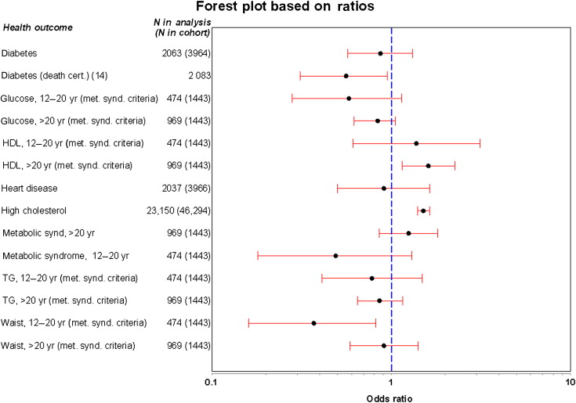
Forest plot
Odds of different outcomes when exposed to a toxin

Slide 13
Difference & Non inferiority (equivalence) hypothesis testing
Difference Testing:
Null Hyp: A=B (or A-B=0), Alternative: A≠B
Z_{obs} = (observed stat – 0) / SE
Non inferiority (within δ) Testing:
Null Hyp: A > B + δ, Alternative: A <= B + δ
Z_{eq} = (observed stat – δ )/ SE
Must specify δ for non inferiority testing
use t instead of Z if variance is not known

Slide 14
Confidence intervals versus hypothesis testing
Study equivalence demonstrated only from –δ to +δ
(1‑8) (brackets show 95% confidence intervals)
Stat
Sig
1. Yes ----------------------------------------------------------------------------------------------- < not equivalent >
2. Yes -----------------------------------------------------------------------------< uncertain >--------------------
3. Yes ------------------------------------------------------------------< equivalent >-----------------------------------
4. No ---------------------------------------------------< equivalent >---------------------------------------------------
5. Yes ----------------------------------< equivalent > ----------------------------------------------------------------
6. Yes ---------------------< uncertain>----------------------------------------------------------------------------------
7. Yes -< not equivalent >-----------------------------------------------------------------------------------------------
8. No ---------<___________________________uncertain________________________________>------
| |
‑δ O +δ
true difference
Ref: Statistics Applied to Clinical Trials- Cleophas, Zwinderman, Cleopahas 2000
Kluwer Academic Pub Page 35

Slide 15
Confidence Intervals, Hypothesis Tests
Confidence intervals are of the form
Sample Statistic +/- (Z_{percentile}*) (Standard error)
Lower bound = Sample Statistic- (Z_{percentile})(Standard error)
Upper bound = Sample Statistic + (Z_{percentile})(Standard error)
Hypothesis test statistics (Z_{obs}*) are of the form
Z_{obs}=(Sample Statistic – null value) / Standard error
* t percentile or t_{obs} for continuous data when n is small. When data does not follow the normal distribution and n is “small”, above are only approximate

Slide 16
Statistical Hypothesis Test Guide
Statistic/type of comparison
Mean comparison-unpaired
Mean comparison-paired
Median comparison-unpaired
Median comparison-paired
Proportion comparison-unpaired
Proportion comparison-paired
Odds ratio
Risk ratio
Correlation, slope
Survival curves, hazard rates
Test/analysis procedure
t test (2 groups), ANOVA (3+ groups)
paired t test, repeated measures ANOVA
Wilcoxon rank sum test, KruskalWallis test*
Wilcoxon signed rank test on differences*
chi-square test (or Fishers test)
McNemar’s chi-square test
chi-square test, Fisher test
chi-square test, Fisher test
regression, t statistic
log rank test*
ANOVA = analysis of variance
* non parametric – Gaussian distribution theory is not used to get the p value

Slide 17
Non parametric Cis & tests
When the sample size is small and when the original distribution is not close to the normal distribution, the sampling distribution for the statistic may not follow the Gaussian, particularly in the distribution “tails”, so another method is needed to generate the sampling distribution, the confidence bounds and the p value. The bootstrap method can always be used. Other methods based on the ranks of the data have been devised. These are called “non parametric” since they do not use the (parametric) Gaussian.

Slide 18
Parametric vs non parametric
Compute p values using ranks of the data.
Does not assume stats follow Gaussian distribution – particularly in distribution “tails”.
Parametric Nonparametric
2 indep means- 2 indep medians-
t test Wilcoxon rank sum test=MW
3+ indep mean- 3+ indep medians-
ANOVA F test Kruskal Wallis test
Paired means- Paired medians-
paired t test Wilcoxon signed rank test
Pearson correlation Spearman correlation
Any parametric test has a corresponding non parametric version.

Slide 19
Power

Slide 20
Nomenclature for Testing
Delta (δ) = True difference or size of effect
Alpha (α) = Type I error = false positive
= Probability of rejecting the null hypothesis when it is true.
(Usually α is set to 0.05)
Beta (β) = Type II error = false negative
=Probability of not rejecting the null hypothesis when delta is not zero
( there is a real difference in the population)
Power = 1 – β
= Probability of getting a p value less than α
(ie declaring statistical significance)
when, in fact, there really is a non-zero delta.
We want small alpha levels and high power.

Slide 21
Hypothesis test decision table
 | No difference in population (Null is true) | Actual difference (Null is false)
Test: Do not reject null | 1-α (correct) | β (Type II error)
Test: Reject null hypothesis | α (Type I error) | 1-β = power (correct)

Slide 22
Alpha versus Power
The top distribution shows the sampling distribution of a test statistic under the assumption that delta (δ) is zero. The null hypothesis is true.
α
The bottom distribution shows the true sampling distribution (unknown at the time of testing), with a true population delta=2.5.
The null hypothesis is false.
1 - β
1 - β

Slide 23
Power for increasing delta
δ =2.5
δ = 0
δ = 3.5
Areas under the curves and right of the vertical line are α for the black curve and power for the other curves.
The power is larger for the red curve than for the blue.

Slide 24
Interpretation of power
If test is “statistically” significant (p < α), we have a “positive” or “significant” outcome & accept the false positive probability of α (ie 0.05).
If test is not statistically significant (p > α) either there is no relationship (“negative” outcome) or sample size is inadequate (inconclusive outcome).
If power is low for a given δ, results are inconclusive, not negative.
If power is high, results are affirmatively negative.
(But better to quote Confidence interval after the study is published)

Slide 25
Power Summary
Power increases as:
True difference (δ) increases
Sample size (n) increases
α increases (less strict significance criterion)
Patient heterogeneity (σ) decreases
Generally, we set α = 0.05 & power = 1 – β = 0.80. To determine n, we need to estimate δ and σ.
Often we use values of δ/σ for the calculation
For time to event outcomes (survival), n also depends on follow up time since “n” is the number of events. The sample size for comparing two survival curves is often computed based on comparing the corresponding two hazards.

Slide 26
Sample Size (n) Checklist
Sample size (n) depends on:
Effect size (δ) = smallest clinically important difference - n increases as δ decreases
Variability (σ) = patient heterogeneity - n increases as variability increases
Power (1-β) = probability of significantly detecting the effect (prob p value < α), often set at 80% or higher - n increases as required power increases
α level = probability of rejecting when δ is equal to its null value (often δ=0),
(two sided α often set to 0.05) - n increases with smaller α - smaller α is more “stringent”
Must also consider the percent who will agree to participate and the accrual rate if all patients are not recruited at the same time.
*** for time to event (survival) outcomes ***
Follow up time = time each patient is followed - n decreases if patients are followed longer. In survival “n” is the number who have the outcome/event.
There are more events if follow up time is increased.
For time to event outcomes, must also consider the patient dropout / loss rate

Slide 27
Sample size per group for δ/σ -unpaired 2 mean comparison, mean difference=δ, SD=σ, two-sided α=0.05
δ/σ | 70% power | 80% power | 90% power
0.10 | 1,234 | 1,570 | 2,102
0.15 | 549 | 698 | 934
0.20 | 309 | 392 | 525
0.25 | 198 | 251 | 336
0.50 | 49 | 63 | 84
0.75 | 22 | 28 | 37
1.00 | 12 | 16 | 21
1.25 | 8 | 10 | 13
1.50 | 5 | 7 | 9

Slide 28
Sample size per group for comparing two proportions, 80% power, alpha=0.05
 | Difference between P₁ and P₂ |P₁- P₂|=δ
Smaller of P₁ & P₂ | 0.05 | 0.10 | 0.15 | 0.20
0.05 | 434 | 140 | 71 | 45
0.10 | 685 | 199 | 99 | 62
0.15 | 904 | 250 | 120 | 72

Slide 29
Power/sample size calculators
Gpower – University of Dusseldorf
(free download)
https://www.psychologie.hhu.de/arbeitsgruppen/allgemeine-psychologie-und-arbeitspsychologie/gpower.html
Columbia University
http://www.biomath.info/power/ttest.htm
Harvard University (Hedwig)
http://hedwig.mgh.harvard.edu/sample_size/

Slide 30
Hypothesis testing limitations

Slide 31
Pseudo replication
Most variation is between persons, not within person.
Two blood samples on n=10 is not a sample size of 20.
Observed value = true population mean
+ between person variation (σ_{p})
+ within person variation (σ_{e})
Example: To estimate the mean
1. Compute a mean for each person using her “m” observations per person.
2. Compute the group mean from the “n” person means.
SEM = √[σ_{p}²/n + σ_{e}²/nm], usually σ_{e} < σ_{p}

Slide 32
Statistical vs Medical “significance”
(“A difference, in order to be a difference, must make a difference”–Gertrude Stein?).
Average drop in weight (kg) after 3 months
Diet | Mean Drop | p | 95% CI
I | 0.50 | <0.001 | (0.45,0.55)
II | 10.0 | 0.16 | (-5.0, 25.0)

Slide 33
p value limitations (ASA)
1. p values do not measure the probability that the studied hypothesis is true, or the probability that the data were produced by random chance alone ignoring the model.
2. Conclusions should not be based only on whether a p-value passes a specific threshold.
3. Proper inference requires full reporting & transparency.
4. A p-value does not measure the size of an effect or the importance of a result.
5. A p-value alone does not provide a good measure of evidence regarding a model or hypothesis.

Slide 34
R A Fisher on p values Statistical Methods and Scientific Inference, Hafner, New York, ed. 1, 1956
“The concept that the scientific worker can regard himself as an inert item in a vast co-operative concern working according to accepted rules, is encouraged by directing attention away from his duty to form correct scientific conclusions,…and by stressing his supposed duty to mechanically make a succession of automatic “decisions”(ie p< 0.05). ...The idea that this responsibility can be delegated to a giant computer programmed with Decision Functions belongs to a phantasy of circles, rather remote from scientific research”. [pp. 104–105]

Slide 35
Multiple Hypothesis testing
Multiple efficacy endpoints /outcomes
Multiple safety endpoints/outcomes
Multiple treatment arms and/or doses
Multiple interim analyses
Multiple patient subgroups
Multiple analyses

Slide 36
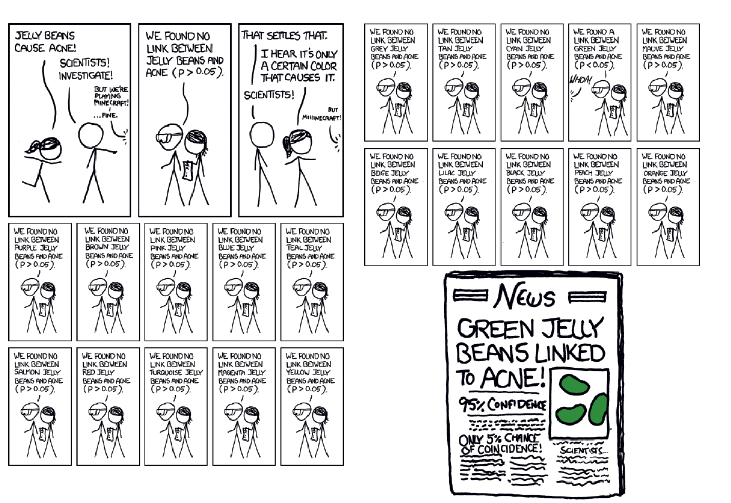

Slide 37
Multiple Testing
Out of m (independent) tests, if one declare “significance” if p< 0.05, below are the number of tests significant by chance alone (FWER), when all null hypotheses are true (assumes independence).
# tests=m | Probability reject at least one=FWER
1 | 0.0500
2 | 0.0975
3 | 0.1426
4 | 0.1855
5 | 0.2262
10 | 0.4013
20 | 0.6415
25 | 0.7226
50 | 0.9231
m | 1-(0.95)^{m}

Slide 38
Exploratory vs confirmatory protein example
750 proteins are compared between two groups – 12 are significant at p < 0.05
Protein name | Atril fib | Atherosclerosis | p value
RAS guanyl-releasing protein 2 | 33.3% | 0.0% | 0.0000
Glutathione S-transferase P | 38.9% | 100.0% | 0.0000
Selenium-binding protein 1 | 22.2% | 0.0% | 0.0000
Nucleosome assembly protein 1-like 4 | 16.7% | 0.0% | 0.0000
Integrin beta;Integrin beta-2 | 11.1% | 50.0% | 0.0000
Spectrin alpha chain, non-erythrocytic 1 | 11.1% | 0.0% | 0.0000
Pituitary tumor-transforming gene 1 protein-interacting | 11.1% | 0.0% | 0.0000
WW domain-binding protein 2 | 16.7% | 50.0% | 0.0000
Syntaxin-4 | 5.6% | 0.0% | 0.0006
CD9 antigen | 27.8% | 50.0% | 0.0013
ATP synthase-coupling factor 6, mitochondrial | 27.8% | 50.0% | 0.0013
Flotillin-1 | 77.8% | 100.0% | 0.0037
Aconitate hydratase, mitochondrial | 38.9% | 50.0% | 0.1142
Fructose-bisphosphate aldolase C | 94.4% | 100.0% | 0.4402
Alpha-adducin | 50.0% | 50.0% | 1.0000
40S ribosomal protein SA | 1.0% | 1.0% | 1.0000
Abl interactor 1 | 1.0% | 1.0% | 1.0000
Bone marrow proteoglycan;Eosinophil granule major basic | 1.0% | 1.0% | 1.0000
Tubulin alpha-4A chain | 100.0% | 100.0% | 1.0000
… (750 proteins total)
Must use stricter criteria (Benjamini,Hochberg…) and validate on new data
Notes:
750 x 0.05 = 37.5

Slide 39
Prevagen & multiple testing (Washington Post – 11 Sept 2021)
Does the supplement Prevagen improve memory? A court case is asking that question
Quincy Bioscience describes the study as a randomized, double-blinded, placebo-controlled trial.
But, according to the FTC and the New York attorney general, the trial involved 218 subjects taking either 10 milligrams of Prevagen or a placebo and “failed to show a statistically significant improvement in the treatment group over the placebo group on any of the nine computerized cognitive tasks.”

Slide 40
The complaint alleges that after the Madison Memory Study failed to “find a treatment effect for the sample as a whole,” Quincy’s researchers broke down the data in more than 30 different ways.
“Given the sheer number of comparisons run and the fact that they were post hoc, the few positive findings on isolated tasks for small subgroups of the study population do not provide reliable evidence of a treatment effect,” the lawsuit said. Post hoc studies are not uncommon but are generally not regarded as proof until confirmed, scientific experts say. According to the Center for Science in the Public Interest, which filed an amicus brief in support of the agencies’ charges, the subsequent analyses produced “three results that were statistically significant (and more than 27 results that weren’t).”

Slide 41
Courtesy of Graph Pad

Slide 42
Multiple testing & primary outcomes
As “m’, the number of outcomes, increases, individual α_{i} for each outcome must be smaller so n must be larger if overall α is to stay constant (ie at α=0.05).
But not all outcomes are equally important. Designate important outcomes “primary” & the rest secondary so ‘m’ is only the number of primary outcomes. Assumes less concern if there is a false positive finding among secondary outcomes.
Must designate primary vs secondary outcomes in advance, before study results are known. It is not fair to declare which outcomes are primary and which are secondary based on their p values.

