Slide 1
Biostatistics review
Jeff Gornbein, Dr PH
Depts of Medicine (GIM) & Computational Medicine (formerly Biomathematics)
David Geffen School of Medicine at UCLA
310-392-7381 gornbein@g.ucla.edu

Slide 2
Suggested Texts
• Medical Statistics at a Glance, 3rd ed
Petrie A, Sabin C, Wiley-Blackwell Pub, 2009 thin, quick & cheap
• Statistics-The art & science of learning from data–A Agresti, C Franklin, B Klingeberg, 4th ed
• Intuitive Biostatistics 4th ed- Motusky H (MD),
Oxford Univ Press 2018
• Designing Clinical Research. 3rd ed
Hully S, Cummings S, Browner W, Grady D, Newman T
Lippincott Williams & Wilkins, 2006
mostly clinical, good sample size tables
• Naked Statistics, Wheelen C, Norton 2013 – Fun!

Slide 3
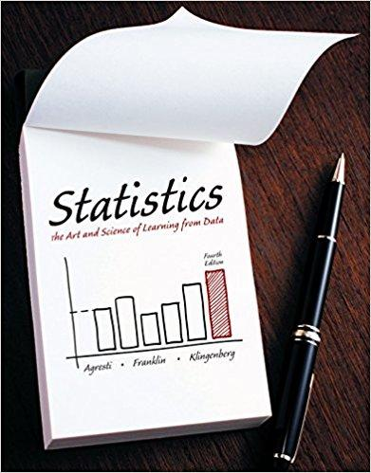

Suggested Texts

Slide 4


Suggested Texts (continued)

Slide 5
Outline
1– Study Design issues: Confounding, Bias, Study Design classification
2- Descriptive statistics for continuous data, survival data and binary data & ROC
3-confidence intervals, hypothesis testing, power, multiple testing
4 (time permitting)- ANOVA, correlation and regression
5 – discussion of paper

Slide 6
1- Confounding, bias &
Study Design

Slide 7
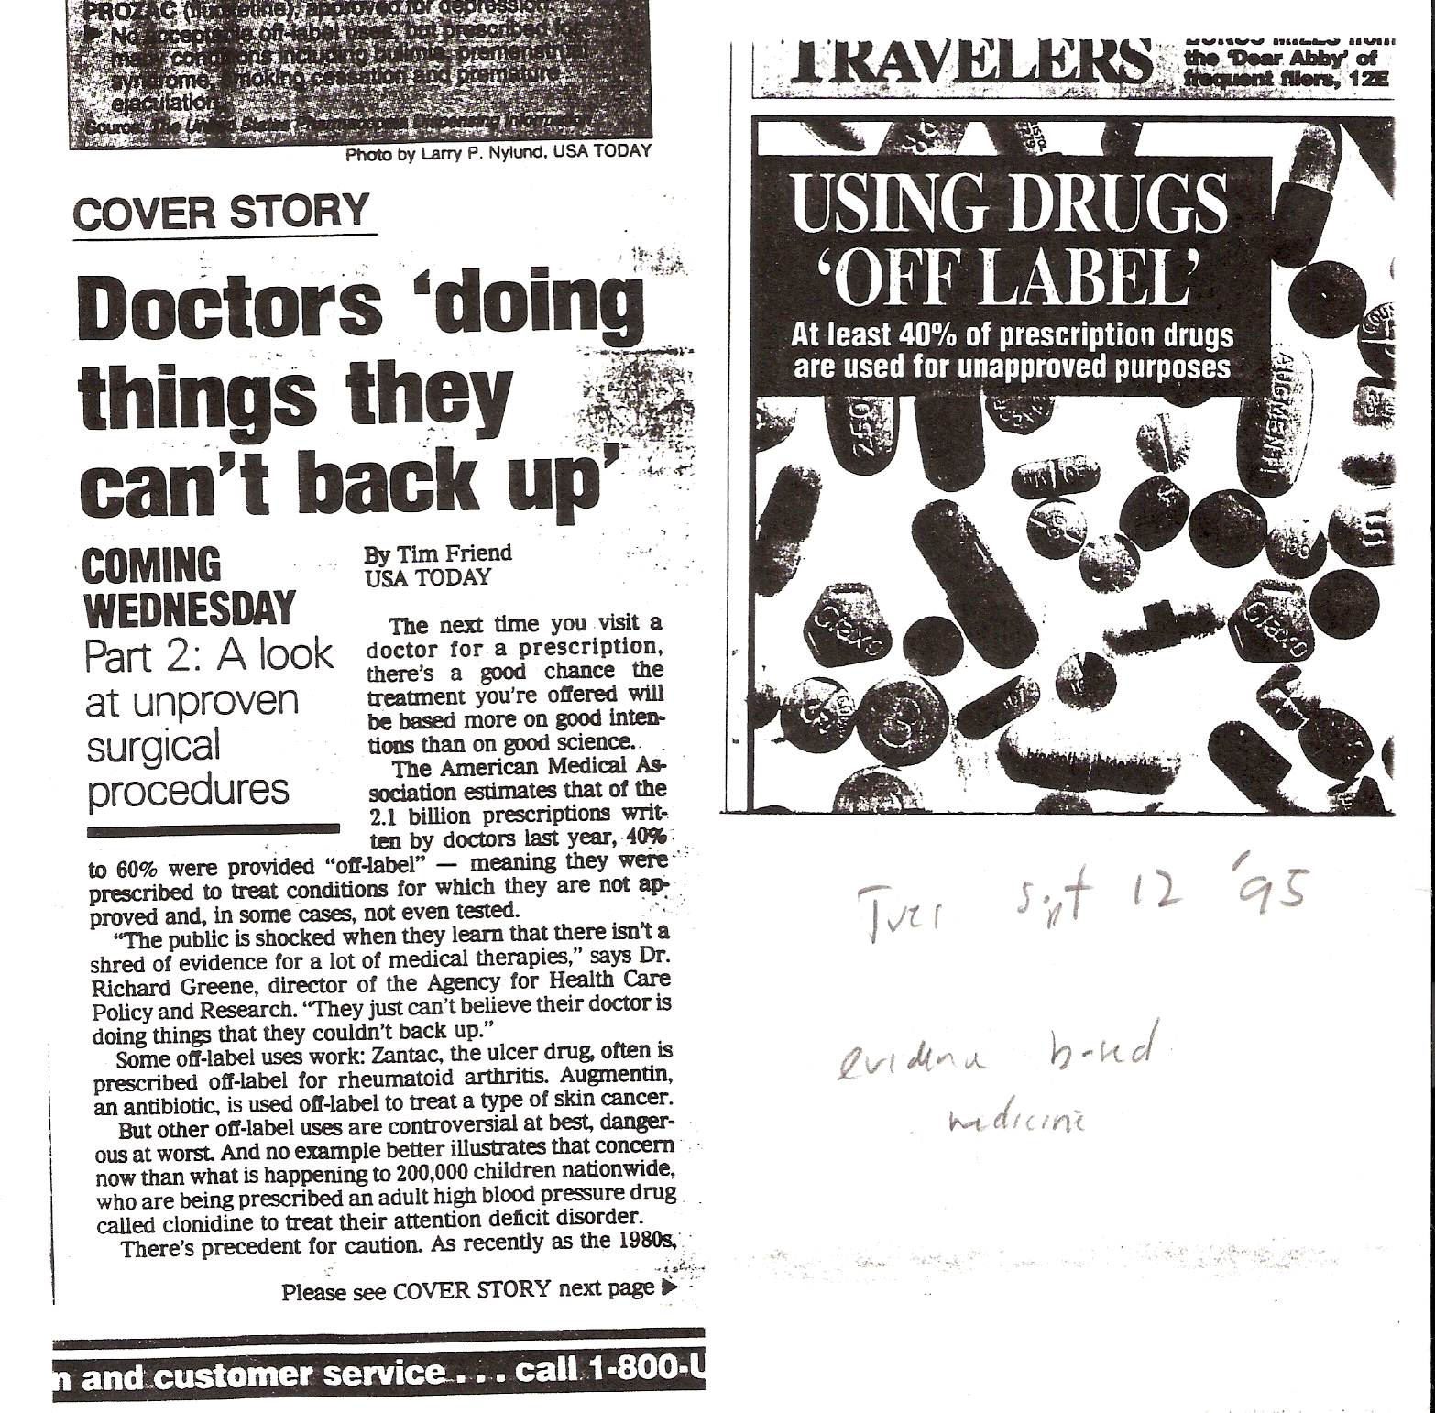
Need “evidence based” medicine

Slide 8
Example – PSA screening for Prostate Cancer
US Preventive Services Task Force (USPSTF)
As late as about 2008, there was a general recommendation that men age 55-69 have a PSA test for Prostate Cancer.
In 2009, randomized trials showed that PSA screening led to many unnecessary surgeries and had a dubious effect on improving prostate cancer deaths. Routine screening in otherwise healtly men is no longer recommended.
(Ref: Ann Intern Med. 2012;157:120-134 )

Slide 9
Cant reproduce findings
Begley(Amgem)-Nature 2012, 483 p 531-533
Fifty-three papers were deemed ‘landmark’ studies. It was acknowledged from the outset that some of the data might not hold up, because papers were deliberately selected that described something completely new, such as fresh approaches to targeting cancers or alternative clinical uses for existing therapeutics. Nevertheless, scientific findings were confirmed in only 6 (11%) cases. Even knowing the limitations of preclinical research, this was a shocking result.

Slide 10
Working definition of causality (or efficacy)
The requirement for "proof"
Definition: We say that “X causes Y” when, all other factors associated with the outcome held constant, a change in predictor X, the "cause" (more frequently) leads to a change in the outcome (or effect) Y. This usually implies a temporal ordering (the cause must happen before the effect) and/or a dose response (the higher the dose of ionizing radiation the higher the probability of getting cancer. So, to establish causality (for disease) or efficacy (for a treatment) there are at least four requirements:
I. Changes in “X” are associated with changes in “Y”
II. Correct temporal ordering (cause X comes before effect Y).
Challenging in observational studies
III. Association between X and Y must not be due to chance alone. This is where inferential statistics (p values, Cis) are useful.
IV. All other effects on Y that are associated with X must be controlled. For comparing X=groups, this implies that the comparison groups must be comparable (no bias, no confounding). Will not happen without proper design.

Slide 11
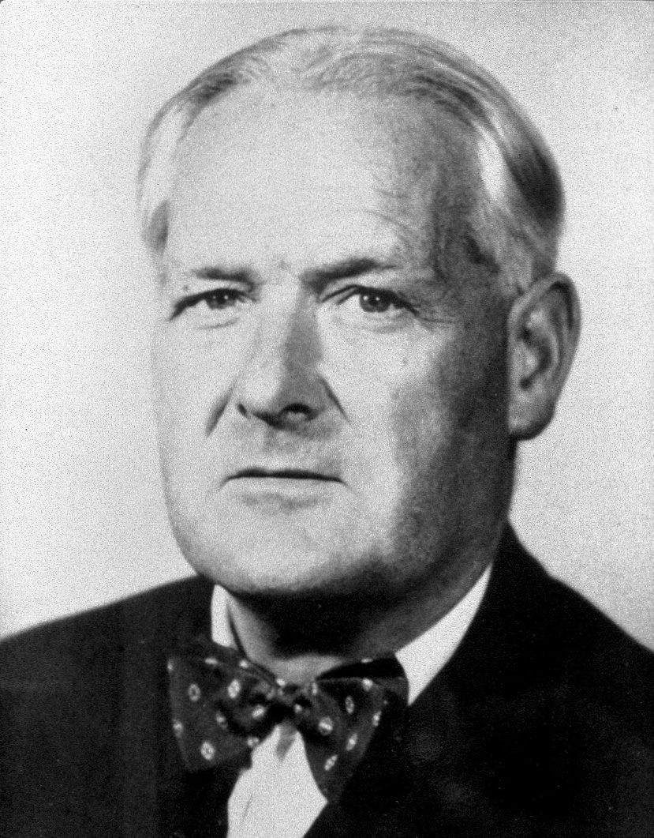
Austin Bradford Hill

Slide 12
Bradford Hill “causation” criteria
1. Consistency: Same finding observed by different persons in different places with different samples
2. Specificity: Causation is likely if seen in a very specific population at a specific site and disease with no other likely explanation. The more specific an association between a factor and an effect is, the bigger the probability of a causal relationship.
3. Temporality: The effect has to occur after the cause. If there is an expected delay between the cause and expected effect, then the effect must occur after that delay.
4. Biological gradient: Greater exposure should generally lead to greater incidence. However, in some cases, the mere presence of the factor can trigger the effect. In other cases, an inverse proportion is observed: greater exposure leads to lower incidence. Sometimes called the “dose-response” effect. Can be “U” shaped (Or inverse U shaped- peak).
5. Plausibility: A plausible mechanism between cause and effect is helpful, but not required.
6. Coherence: There is coherence (agreement) between epidemiological and laboratory findings .
7. Experiment: Relationship can be investigated in an experiment. Not always possible.
8. Analogy: The effect of similar factors may be considered.

Slide 13
Confounding- important
Wish to evaluate association between X & Y
X outcome (Y)
C=Confounder
variable C is a confounder if:
associated with risk factor X (double arrow)
but not a cause of X, or caused by X
2) an independent risk factor for Y (single arrow pointed at Y)

Slide 14
Confounding
Diet Weight loss
Exercise
Key
= causation (uni direction)
= association (bi direction)

Slide 15
Not a confounder–intermediate risk factor
(mediator)
drug → serum cholesterol → MI or stroke
When looking at heart disease risk comparing two or more drugs for lowering cholesterol, we would not control for post drug cholesterol level. This would remove or reduce the effect we were trying to study.

Slide 16
Collider
Artifactual relationships may appear even though there is no causation or association. Example:
Flu Fever food poisoning
One incorrectly thinks getting the flu is associated with food poisoning since both cause fever. Should NOT stratify on fever when assessing association between food poisoning and Flu.

Slide 17
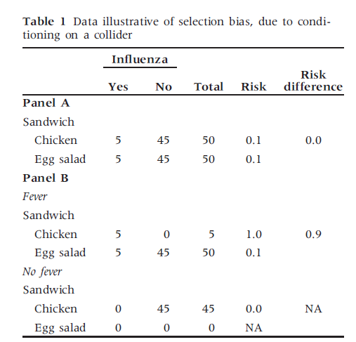
Egg salad causes fever but not flu
Flu causes fever
Cole, Int J Epi, 2009, 1-4

Slide 18
Easy to be mislead when one does
not control for confounding
cholesterol in mg/L
No apparent gender difference
Statistic Males Females
Mean 205 205
SD 30 29
n 100 100
SEM 3.0 2.9

Slide 19
Cholesterol (mg/dl) in males and females- No apparent gender difference
variable | Male | Female
mean age | 30 | 40
mean chol | 205 | 205
The mean cholesterol ignoring age is the same in male & females
But controlling for age, males are higher than females

Slide 20
Depression in males vs female
Depression score from 0 (good) to 100 (bad)
Gender mean depression score
Males 66
Females 76
p < 0.001

Slide 21
Depression scores in males versus females
variable | Male | Female
income | 17,000 | 12,000
mean depr | 66 | 76
Males seem to have lower depression than females
Controlling for income (ie SES), depression is the same in males and females

Slide 22
Effect modification
When effect is not the same at all levels of the confounder (non parallel, interactions), confounder is often called an effect modifier (moderator)
When young, chol is higher in males but gap narrows with age

Slide 23
Is lumpectomy bad?

Slide 24
Fisher et. al. Oct 2002 NEJM p1233
Background
In 1976, we initiated a randomized trial to determine whether lumpectomy with or without radiation therapy was as effective as total mastectomy for the treatment of invasive breast cancer.
Methods
A total of 1851 women for whom followup data were available and nodal status was known underwent randomly assigned treatment consisting of total mastectomy, lumpectomy alone, or lumpectomy
and breast irradiation. Kaplan–Meier and cumulative- incidence estimates of the outcome were obtained.

Slide 25
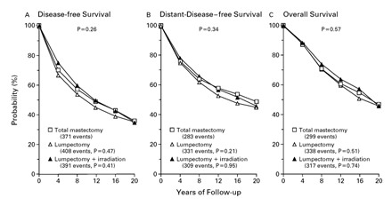
Fisher et. al. Oct 2002 NEJM p1233

Slide 26
Bias (internal bias)
Bias ≠ Confounding
Confounding: Usually due to a patient variable/action rather than the action of the investigator
Bias: Usually caused by action taken (or not taken) by the investigator

Slide 27
Major Types of bias- not exhaustive
Variable observer bias - The apparent effect is due to a difference in the observers (ie. the MD) and not to a true difference in the outcome. “Calibration” bias.
Hawthorne effect - The subject (patient) changes his response in the presence of the questioner (physician). Showing interest in a patient changes their response.
Response bias - The way and conditions under which the question is asked affect the answer. Hawthorne effect is a specific response bias.
Diagnostic accuracy bias - The accuracy of the diagnosis changes (usually improves) over time. Causes apparent disease incidence to change.
Lead time bias – Survival time seems to increase because of earlier diagnosis, not better treatment.
(screening tests)

Slide 28
Major biases (continued)
• Confirmation bias - The investigator tends to omit data / observations that do not confirm the investigator’s hypothesis. (“This observation is an outlier”) and / or interprets results to favor the hypothesis. Can extend to choosing the statistical analysis method that favors the hypothesis.
• “Publication bias (a “meta” bias) - Negative results are not interesting and less likely to be published. Results unfavorable to the hypothesis are withheld from publication.

Slide 29
Survival / dropout bias -Only those healthy enough to survive until data is collected can provide data.
Ex – WBC toxicity in chemo
Treatment A Treatment B
Mean WBC 5600 4200
Sample size (n) 67 89
Is B really more toxic than A (lower WBC)?
The n is smaller in A since more died.

Slide 30
Dropouts in a clinical trial are a major potential source of bias even though patients may be randomized to treatment.
Must report dropouts, compare baseline characteristics in dropouts versus non dropouts to see if dropouts are at random or are systematic (ie older, sicker more likely to drop out)

Slide 31
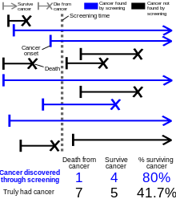
Length time bias
(evaluating screening efficacy)
In a screening program, those with rapidly developing disease (for example, fast growing cancers) are less likely to be screened. They will only show up after they have symptoms. Thus, may appear that those screened have better survival if survival is related to growth rate.

Slide 32
Lead time bias
(evaluating screening & early treatment)
Similarly, those in a screening program may have their disease (cancer) detected earlier. This time is added to their “survival” time (time from diagnoses to endpoint) making it seem longer due to early treatment, not just earlier detection.

Slide 33
Some sources of bias
Study design: Absence of a control group
Wrong type of controls used
Lack of control for other prognostic factors
Sample selection: Poor eligibility (inclusion/exclusion) criteria
Can’t generalize to population of interest from "grab" (convenience) samples (external bias)
Refusals – sickest persons may not agree to participate
Conduct of study: Differential dropouts – More/sicker dropouts in one group (like survival bias)
Poor and differential diagnosis and supportive care
Patients in treatment group get more attention than controls
Inadequate evaluation methods
Poor data quality, errors and missing data

Slide 34
External bias / lack of validity
(non representative sample)
The term "bias" is also used when the study sample is not representative of the target population of interest. This is "external" bias or "selection" bias as noted above. Often, groups may be comparable within a study but results cannot be generalized to a wider population.

Slide 35
Example: Selection bias
10,000 are addicted to opioids & need treatment
2,000 seek treatment
1,000 begin treatment with device
200 begin and complete treatment with device
Of the 200, 70 are cured so the “success rate” in the 200 is 35%. But is this the success rate in all who would use the device? In all those seeking treatment? In all who are addicted (and need treatment?)

Slide 36
How to deal with confounding?
1. By study design (inclusion/exclusion, randomization …)
2. By stratification (group matching) or individual matching on confounders (can be part of the design)
3 By statistical modeling
(regression is one example)

Slide 37
Regression (more later)
Hazard rate ratio (HR) for breast cancer recurrence in those who had neo adjuvant treatment versus no neoadjuvant treatment (H Chang)
Ignoring confounders
Haz Rate Ratio | Lower CL | Upper CL | p value
0.55 | 0.13 | 1.62 | 0.3075
Controlling for confounders
Predictor | Haz Rate Ratio | Lower CL | Upper CL | p value
Neoadjuvant chemo | 0.20 | 0.04 | 1.00 | 0.0483
Pre-Menopausal (vs post) | 2.12 | 0.72 | 6.25 | 0.1853
Positive nodes (yes or no) | 3.64 | 1.29 | 10.28 | 0.0152
Stage 2 vs 1 | 8.30 | 2.11 | 32.59 | 0.0007
Stage 3 vs 1 | 2.67 | 0.42 | 17.07 | 0.3063
Stage 4 vs 1 | 46.83 | 7.94 | 276.3 | <.0001
Positive tumor margin | 3.14 | 1.15 | 8.59 | 0.035

Slide 38
Study Design

Slide 39
Study Design Hierarchy
studies
experiments
observational
cohort
cross sectional
case control
randomized
non randomized
diagnostic validation
parallel groups
crossover
parallel groups
before-after
historical controls
Non randomized studies much more subject to confounding!

Slide 40
Experiments = clinical trials
For assessing treatments
• Premeditated nonstandard treatment intervention
Primary purpose to evaluate the relative efficacy of the treatments.
Study is an experiment when the main reason for treatment assignment is to make comparisons possible and at least one of the treatments is not part of the standard therapy.
Does not require randomization (quasi expt) or blinding to be an experiment

Slide 41
Experimental designs
Randomized controlled trial (RCT)
Crossover trial
Quasi-experiment= Parallel group trial
Self control, before and after trial
(no controls-”case series”)
External or Historical controls
Diagnostic assessment study (medical test)

Slide 42
RCT
Example: Breast cancer patients are randomized to surgery with standard chemo (group A) vs surgery with standard chemo + Herceptin (group B)
Group A
Screen ->Enroll & randomize
Group B
Primary Outcome: Disease free survival

Slide 43
Parallel groups-Quasi Expt
Example: Those taking aspirin are compared to those not taking aspirin. Patients gets to decide if they take aspirin (self assigned). NOT randomized but ascertained at the same calendar times (parallel in time).
Group A
Screen ->Enroll
Group B
Outcome: Time to first heart attack

Slide 44
Before-after trial paired trial (“case series”)
bacteria before - mouthwash - bacteria after
Acne on left side – placebo treatment
Acne on right side – antibiotic treatment
In these studies, same person is measured twice (or many times – repeated measures)
There is no control group – Often assume the behavior of the outcome is known with no treatment.

Slide 45
Example: before-after trial
Nonconventional treatment for pain
(see Bausell)

Slide 46
Crossover trial
Treatment A – washout - Treatment B
Screen-> enroll &randomize
Treatment B – washout – Treatment A
***************************************************************************
Historical controls
Example: Breast cancer survival in those before herceptin was introduced in 1997 Is compared to with survival in those given herceptin after 1997.

Slide 47
Diagnostic validation assessment
One diagnostic test is compared to another or to a “gold standard”.
Example: Colposcopy is compared to pap smear for cervical cancer.
Gold standard is biopsy. Hard to do since all women must be biopsied in order to fairly estimate sensitivity, specificity and not just predictive values.

Slide 48
Factorial experimental design
Evaluate several factors at same time
No C
 | No B | B
Low A | Y | Y
Med A | Y | Y
High A | Y | Y
C
 | No B | B
Low A | Y | Y
Med A | Y | Y
High A | Y | Y

Slide 49
Additivity vs interactions
Factorial designs allow assesement of additivity
Example: If factor A increases the outcome by “5” units without B, and factor B increases the outcome by “3” units without A, A and B are said to be additive if their combination (A+B) increases the outcome by 5+3 = 8 units.
If the increase due to A+B is MORE than 8 units (more than their sum) the effect is called synergistic. If the effect is less than 8 units (less than their sum) it is antagonistic.

Slide 50
Survival at 3 years in MI patients on standard treatment plus anti arrhythmic and/or NSAID
.
treatment | low dose NSAID | high dose NSAID
no anti arrhythmic tx | 60% | 80%
anti arrhythmic tx | 70% | ??

Slide 51
Survival at 3 years in MI patients on standard treatment plus anti arrhythmic and/or NSAID
Factorial design can identify interactions.
Not discovered if only one factor varied and the others held constant.
treatment | low dose NSAID | high dose NSAID
no anti arrhythmic tx | 60% | 80%
anti arrhythmic tx | 70% | 65%

Slide 52
Interaction example- tumor volume

Slide 53
Repeated measure design
Each subject measured repeatedly over time. A paired comparison
is a special case. Treatment is the “between group” factor, and time is
the “within group” factor. Measuring the same person four times is NOT the same as measuring four different groups once so the between group and within group comparisons have different statistical properties.
 | Time 1 | Time 2 | Time 3
Treatment A | Y | Y | Y
Treatment B | Y | Y | Y

Slide 54
Cross over design
Outcome- pct with relief from chronic migraine headache
Ideal result-
No period effects, no carry over (order) effects
Order | Period 1 | Period 2
T-P | 43% (Timolol) | 27% (Placebo)
P-T | 27% (Placebo) | 43% (Timolol)
There is a 43%-27%=16% improvement due to Timolol

Slide 55
Cross over design
Outcome- pct with relief from chronic migraine headache
Period effect
Order | Period 1 | Period 2
T-P | 43% (Timolol) | 37% (Placebo)
P-T | 27% (Placebo) | 53% (Timolol)
There is a 16% improvement due to Timolol and a 10%
Improvement due to time period

Slide 56
Cross over design
Outcome- pct with relief from chronic migraine headache
Carryover (order) effect
Order | Period 1 | Period 2
T-P | 43% (Timolol) | 41% (Placebo)
P-T | 27% (Placebo) | 43% (Timolol)
Giving Timolol “cures” 14-16% of patients. Only period 1 gives unbiased estimate

Slide 57
Experiments - Disadvantages
Experiments are very costly in time and money.
Many research questions can’t be addressed because of ethical problems or disease is too rare
Physicians and patients often unwilling to participate, particularly in randomized trials.
Inappropriate use of historical controls or no controls can produce major errors! (less of a problem with concurrent controls)
Answers from standardized clinical trials may be different from the behavior in general practice. For example only a single fixed dose may be evaluated in a trial, whereas the general practice uses many doses.
Trials tend to restrict the scope and the questions under study.
Experiments - Advantages
Experiments are usually in the correct temporal order
Properly controlled and designed experiments produce strongest evidence for cause & effect or lack thereof. May be unethical to give a treatment that does not work. Important in an era of proliferating medical technology.
Randomized trials are best for assuring comparability and best for controlling confounding and bias.
Sometimes required by the Govt. (FDA and new drugs)
Can be faster and cheaper in the long run if they put a controversy to rest.

Slide 58
Criteria for the “best” experiments/trials
(Bausell R, Snake Oil Science, Oxford Univ Press, 2007)
1. Randomized Trial
2. Double blind (if applicable)
3. Large sample size (at least 50/group)
4. No more than 25% dropouts in any group
5. Published in high quality peer reviewed Journal

Slide 59
Observational studies
Cohort/prospective/longitudinal
Historical Cohort (some call “retrospective”)
Cross sectional-survey
Case-Control (true “retrospective”)
“Ecologic” – aggregate units

Slide 60
Cohort: Coffee vs Pancreatic cancer
(Michaud et. al., Cancer Epi Biomark, May 2001)
1980 Nurses Health study, 1986 Health professionals study
136,593 persons. Most followed to 1996+
n=35,738 no coffee, n=27,012 w/ 4+ cups
RR=0.62,
95% CI for true RR (0.27, 1.43)
For 4+ cups/day vs no coffee

Slide 61
COHORT - advantages
Establishes sequence of events
Avoids bias in measuring predictors
Avoids survival bias
Can study several outcomes
Yields incidence, relative risk, risk difference
Gives control of selection of subjects and over what to measure
Outcome not likely to affect the selection of subjects (no selection bias)

Slide 62
COHORT – disadvantages
Usually need large sample size
Not feasible for rare outcomes/diseases
May have long duration
May have dropouts/loss to follow up
Does not guarantee comparability

Slide 63
Cross sectional example:
MESA data in FY 2000
log HOMA Insulin resistance (IR) By BMI
n=750, r= -0.45, r_{s}= -0.46, p < 0.001

Slide 64
Cohort effect in cross sec study
Red descending line is misleading

Slide 65
Cross-sectional: advantages
Can study several outcomes at same time
Can study several exposures at same time
Short study duration
Provides prevalence (not incidence)
Can be front end of a cohort study

Slide 66
Cross sectional:disadvantages
Does not establish temporal order
Exposure info from memory may not be accurate (recall bias)
Only survivors can be measured – survival bias
Not feasible for rare diseases
Can’t distinguish between predictors of disease occurrence vs disease progression
Can’t provide incidence
Assumes observed associations across persons are the same as associations across time within a person
(In Miami, young Cuban males grow up to be old Jewish males)

Slide 67
Case control : example
Coffee & Pancreas cancer
(MacMahon et. al. NEJM, March 1981)
369 with histologic confirmed cancer
644 controls (no cancer)
OR=2.7
95% CI (1.6 to 4.7)
For 3+ cups/day vs no coffee

Slide 68
Case-Control: advantages
Feasible for rare diseases
Short duration
Inexpensive - easy to do
Can evaluate many risk factors at once

Slide 69
Case-control:disadvantages
Bias from sampling possibly two populations-not one population with or without disease
(where do we get appropriate controls?)
Does not establish temporal order
Recall bias
Survival bias
Can’t estimate incidence or prevalence
Case control is weakest design but easiest to do

Slide 70
“Ecologic” fallacy
income
Months job training

Slide 71
Ecologic Fallacy

Slide 72
Exploratory vs Confirmatory
Experiments & observational studies can be classified as exploratory or confirmatory
Exploratory study -> hypothesis generating
(“fishing expedition”)
Liberal criteria ok for “significance”
Ex: Phase I and II trials
Confirmatory study->hypothesis validating
Need strict criteria for confirmation
Ex: Phase III and IV trials
Good studies are validated on another dataset!

Slide 73
Statistical methods to control for confounding
Stratification (group matching)/ matching
Propensity scores
Rate adjustment
Regression (linear, logistic, proportional hazard, ANOVA, Poisson…)
This is needed when one can’t randomize or match/pair.

Slide 74
Outline for assessing an article in the Biomedical literature
(Colton: Statistics in Medicine)
I. Objectives
a. What is the goal or purpose of the study? What scientific hypothesis is being tested?
b. What is the target population – to whom do the investigators wish to apply the results? Who was included and excluded?

Slide 75
II. Study design
a. Is the study a planned experiment, quasi experiment or observational study?
b. What is the population from which the sample was selected?
c. How was the sample selected/participants chosen? Are their sources of bias? Are reasons for inclusion and exclusion of study subjects defined?
d. If the study was an experiment, were the subjects randomly assigned to treatment? Was the randomization scheme stated?
e. Was there an adequate control group?
f. Are the groups comparable at baseline?
g. Was there a sample size calculation in the planning?

Slide 76
III. Observations
a. What are the outcome measures? Are they clearly defined?
b. What are the predictors and relevant covariates?
c. Are the measures reproducible (reliable) and understandable?

Slide 77
IV. Analysis
a. What statistical hypotheses are being tested? Is this consistent with the goals in part I?
b. What type of analyses and statistical tests were performed? Are the calculations correct? Are the analysis methods consistent with the nature of the data?
c. What assumptions have been made about the data or design? Are they reasonable?
d. Have important, relevant factors and extraneous influences been accounted for in the analysis? Were confounding factors controlled?
e. Were the analysis results properly interpreted?
f. Were negative results distinguished from inconclusive results? Was the sample size large enough?

Slide 78
V. Presentation
a. Are the data and findings presented clearly? Is there sufficient detail to allow the reader to judge them?
b. Are the findings internally consistent? Do numbers add up and match in various tables and figures?

Slide 79
VI. Conclusions
a. What conclusions do the investigators draw? Do they exceed the data presented?
b. Do the conclusions related to the goals of the study? Do they answer the study questions?

Slide 80
VII. Redesign / reanalysis
If parts of the design or analysis are thought to be inadequate, how would you would redesign the study and/or reanalyze the data. Be practical. That is, recognize that there are financial, time and ethical limits to the types of studies that can be carried out.

Slide 81
2-Descriptive statistics

Slide 82
Continuous data checklist
Central tendency
Mean
Median
Mode
Geometric mean
Variation (“Spread”)
Range
Interquartile range (Q3-Q1)=IQR
Standard deviation
Normal distribution – report mean and SD
Non normal, non symmetric distribution – report median and IQR, not mean and SD

Slide 83
Geometric mean
Y log₁₀ Y
10 1
100 2
1000 3
Mean 370 2
Geometric mean = 10² = 100 ≠ 370
Geometric mean=antilog of the log scale arithmetic mean. Geometric mean is about the same as the median if data has normal distribution on the log scale.

Slide 84
Data distributions that tend to be Gaussian (normal) on the log scale
Growth measures - bacterial CFU
Ab or Ag titers (IgA, IgG, …)
pH
Neurological stimuli (dB, Snellen units)
Steroids, hormones (Estrogen, Testosterone)
Cytokines (IL-1, MCP-1, …)
Liver function (Bilirubin, Creatinine)
Hospital Length of stay (can be Poisson)

Slide 85
Survival Data

Slide 86
Stomach cancer survival days-Cameron & Pauling
day | cum dead | cum incidence | survival
4 | 1 | 7.7% | 92.3%
6 | 2 | 15.4% | 84.6%
8 | 4 | 30.8% | 69.2%
12 | 5 | 38.5% | 61.5%
14 | 6 | 46.2% | 53.8%
15 | 7 | 53.8% | 46.2%
17 | 8 | 61.5% | 38.5%
19 | 9 | 69.2% | 30.8%
22 | 10 | 76.9% | 23.1%
24 | 11 | 84.6% | 15.4%
34 | 12 | 92.3% | 7.7%
45 | 13 | 100.0% | 0.0%

Slide 88
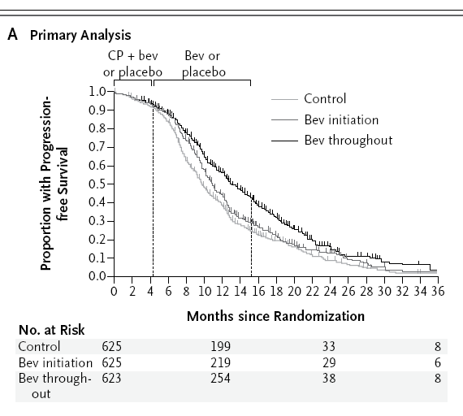
Bevacizumab & Ovarian Cancer
Berger et. al. NEJM Dec 2011

Slide 89
Why survival curves?
Comparisons too “early” or too “late” will always make the groups seem the same.

Slide 90
Summarizing mortality – hazard rates
Hazard rate = h =
number of persons with outcome
total person-time follow up in all at risk
This is a rate per person-time.
It is NOT a probability (not a “risk”)
In stomach cancer n=13, with 13 deaths, total follow up is
4+6+8+8+12+14+15+17+19+22+24+34+45
= 228 person-days
Hazard rate = mortality rate =
13/228 = 0.057 or 5.7 deaths per 100 person-days of follow up.
Do NOT report as 5.7% risk-wrong
If all subjects have outcome, h= 1/mean time to outcome

Slide 91
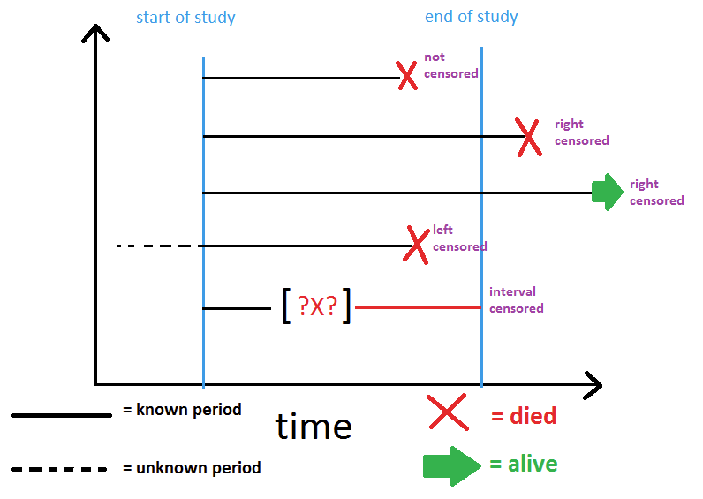
Censoring-hazard rates valid with censored data
(means not valid or even defined)

Slide 92
Example: Why hazard rates?
Group n num dead mean f/u total f/u rate per 1000
A 100 7 36 3600 7/3600=1.94
B 100 2 3 300 2/300 =6.66
Mortality rate is higher for B than A even though the number of persons in each group is the same and more people died in group A.
The hazard rate ratio for A/B is 1.94/6.66=0.291.
When ALL patients are followed to the endpoint, (no censoring) mean time to event= 1/hazard.

Slide 93
Hazard rates & survival curves
log_{e}(S) =cum hazard= -h t, h is (average) slope of log_{e}(S) vs t

Slide 94
Hazard rate ratios & Survival curves
h_{a} = hazard rate in group A h_{b} = hazard rate in group B,
hazard rate ratio, (HR) for A compared to B is
HR = h_{a}/h_{b}
If HR is constant over time one can compute the Survival in group A from the Survival in group B.
S_{a} = S_{b}^{HR}
Ex: HR=0.291, S at t=12 mos is 90% in group B, S=0.90^{0.291} = 0.970 or 97.0% in group A at t=12 months.
A “protective” HR < 1 increases survival. HR >1 decreases survival.

Slide 95
Competing risks - definition
Subjects can die from more than one cause or can experience more than one mutually exclusive endpoint.
For example, patients can die from heart disease or cancer. They usually die from one or the other, not both.
When there are two or more mutually exclusive endpoints, these are called “competing risks”.
When analyzing time to one competing endpoint, one CANNOT exclude or censor subjects who experienced the other endpoints. (Censoring at time “t” removes them from the “risk set” – the set of those at risk, at time t.
At any moment in time, the total of those who did not experience any endpoint, experienced endpoint 1, endpoint 2 … must be 100%.
Silly example: In 100 subjects, if 40 die of heart disease and 10 die of cancer, the risk of death from heart disease is 40/100, not 40/(100-10)=40/90. Cannot exclude or censor the 10 who died of cancer.

Slide 96
Competing risks
Above shows the incidence of each endpoint (inc 1, inc 2) and the “survival” of those who have not experienced any endpoint. Total at any time is 100%.

Slide 97
BINARY DATA
Statistics

Slide 98
Associations for Binary data
 | disease | No disease | total
Exposed (e) | a | b | a+b
Unexposed(u) | c | d | c+d
risk=P odds=O
P_{e}= a/(a+b) O_{e}= a/b
P_{u} = c/(c+d) O_{u}= c/d
RR =P_{e}/P_{u} OR= O_{e}/O_{u}

Slide 99
Risk vs Odds
P=risk, O=odds
O=P/(1-P), P=O/(1+O)
P=1/10, O=1/9.
Risk=num sick/total
Odds=num sick/num not sick
RR = OR/(1 – P_{u} + OR P_{u})
When P_{u} is small,
RR=OR
In general, OR is more extreme than RR

Slide 100
Oral Contraceptive exposure vs Cancer
Prospective study (unbiased est of pop)
 | disease | no disease |  | risk | odds
exposed | 50 | 950 | 1000 | 0.050 | 0.053
unexposed | 200 | 8550 | 8750 | 0.0228 | 0.0234
 | 250 | 9500 | 9750
OC use (P) | 20% | 10% |  | RR | OR
 |  |  |  | 2.188 | 2.250

Slide 101
Ratios and differences
For rare events or diseases
P_{e=}1/10,000, P_{u}= 1/100,000
RR = 10, risk difference = 9/100,000
Misleading to only report ratio and not actual risks.

Slide 102
Odds-case control study
 | cancer | No cancer
OC | 100 | 5
no OC | 400 | 45
 | 500 | 50
OC use (P) | 20% | 10%
Odds (O) | 0.25 | 0.11
OR | 2.25

Slide 103
Why use ORs?
1.In prospective study, usually quote disease risk & risk ratio (RR).
In case-control, we always quote OR, not RR.
Case-control OR of exposure in disease/no disease
Equals
Prospective OR of disease in exposed/unexposed
in population if the probability of exposure is same as in the target population.
(Not necessarily true if there is confounding, bias).
2. OR more “stable” (universal) across studies.
If unexposed risk=20%, RR=2, exposed risk=40%
If unexposed risk=60%, RR can’t be 2.

Slide 104
Independence rule for ORs
ORs for heart attack (MI)
For smokers/non smoker: OR = 4
For alcohol/no alcohol: OR = 2
If independent, OR for those who smoke AND drink alcohol is 4 x 2 = 8 (relative to no smoke, no alcohol).
Only true if smoking, drinking are independent influences on MI. However, smoking & drinking can be correlated with each other.

Slide 105
Risk Reduction (clinical trials)
P_{c} (like P_{u})=prop w/ disease in control group
P_{t} (like P_{e})=prop w/ disease in treated group
ARR=Absolute risk reduction=
risk difference= RD=P_{c}-P_{t}
RRR=Relative risk reduction=(P_{c}-P_{t})/P_{c} =
ARR/P_{c} =1- (P_{t}/P_{c}) = 1-RR
(RRR is also the definition of vaccine efficacy)
NNT=number needed to treat=1/ARR

Slide 106
Relative risk reduction
Pfizer COVID vaccine trial:
P_{c}=850/22685=3.75%, Q_{c}=96.25% no vaccine
P_{t} = 77/23621=0.33%, Q_{t}=99.67% with vaccine
P_{c}-P_{t}=3.42%, RRR=3.42% /3.75%=91.3%
= “efficacy”

Slide 107
NNT – number needed to treat (or harm)
(clinical trials)
Example
P_{c}=0.36=36%, P_{t}=0.34=34%
ARR=RD=0.02=2%
RRR=0.2/0.36 = 5.5% (a percent of a percent)
NNT = 1/0.02 = 50
So 50 patients must be given the treatment to cure one additional disease case.
Can be extended to more complex stats.

Slide 108
Summary-Ratios
Risk Odds Hazard
P O h
Ratio: RR=P_{e}/P_{u} OR=O_{e}/O_{u} HR=h_{e}/h_{u}
All have the null value of 1.0 when there is no association. The distribution of the logs of their ratios from study to study are usually bell curve shaped around the true log scale value.

Slide 109
Sensitivity and Specificity
 | True-disease | True-No disease
Test-positive | a | b
Test-negative | c | d
Total | a+c | b+d
Sensitivity=a/(a+c), false negative=c/(a+c)
Specificity=d/(b+d), false positive=b/(b+d)
Positive predictive value=PPV=a/(a+b) *
Negative predictive value=NPV=d/(c+d) *
* Depends on disease prevalence-not just attribute of test

Slide 110
Sensitivity, Specificity, Accuracy
Accuracy = W Sensitivity + (1-W) Specificity
where 0 < W < 1.
Often W=0.5 (unweighted accuracy)
We wish to maximize accuracy=minimize misclassification = 1- Accuracy
Choose W depending on “costs”.

Slide 111
ROC curve–choose continuous data cutpoint (threshold) for highest accuracy, best “separation”

Slide 112
“Modern” format for ROC
Highest accuracy is NOT necessarily where sens=spec,
(only when SD₁=SD₂)

Slide 113
“Traditional” ROC
(not recommended-hard to label cutpoints)

Slide 114
C (concordance) statistic for ROC
C = area under the “traditional” ROC curve
0.5 (bad) < C < 1.0 (good)
If n_{d}=a+c true num w/disease
n_{nd}=b+d true num w/o disease
From all possible n_{d} x n_{nd} pairs with one diseased and one not, call a pair “concordant” if diseased is positive and non diseased is negative.
C is the proportion of the pairs that are concordant.

Slide 115
Positive and Negative predictive value
Positive predictive value (PPV) & negative predictive value (NPV)
depend on sensitivity (sens), specificity (spec) & disease prevalence (P).
Sensitivity and specificity do NOT depend on disease prevalence.
Can only compute PPV=a/(a+b) & NPV=d/(c+d) when disease prevalence P = (a+c)/(a+b+c+d) = (a+c)/n
Bayes formulas for PPV and NPV
Let P = prevalence of disease
PPV = test true pos/ (test true pos + test false pos) =
sens x P / [ sens x P + (1- spec) x (1-P) ]
NPV = test true neg/ (test true neg + test false neg) =
spec x (1-P) / [ spec x (1-P) + (1-sens) x P ]
But don’t have to use these formulas – there is an easier way

Slide 116
Example with formula
 | disease | no disease | Total
Test positive | 95 | 20 | 115
Test negative | 5 | 1980 | 1985
Total | 100 | 2000 | 2100
Sens = 95/100=0.95, Spec= 1980/2000 = 0.99,
Disease prevalence=P = 100/2100 = 0.0476
PPV = (0.95 x 0.0476) / [ 0.95 x 0.0476 + 0.01 x 0.9524 ] = 0.826
PPV = 95/115=0.826
NPV = (0.99 x 0.9524) / [0.99 x 0.9524 + 0.05 x 0.0476] = 0.9974
NPV = 1980/1985 = 0.9974

