Slide 1
Section 6
Comparing means & analysis of variance

Slide 2
How to display means-
Bars ok in simple situations

Slide 3
Presenting means - ANOVA data
One can also add “error bars” to these means. In analysis of variance, these error bars are based on the sample size and the pooled standard deviation, SDe. This SDe is the same residual SDe as in regression.

Slide 4
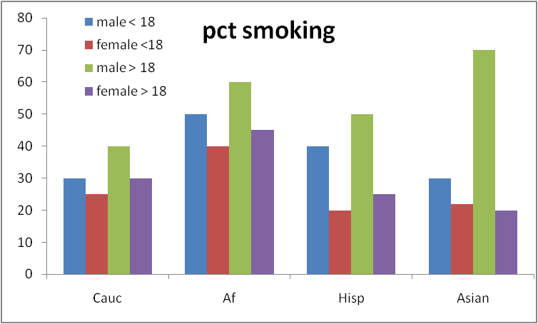
Don’t use bar graphs in complex situations
4

Slide 5
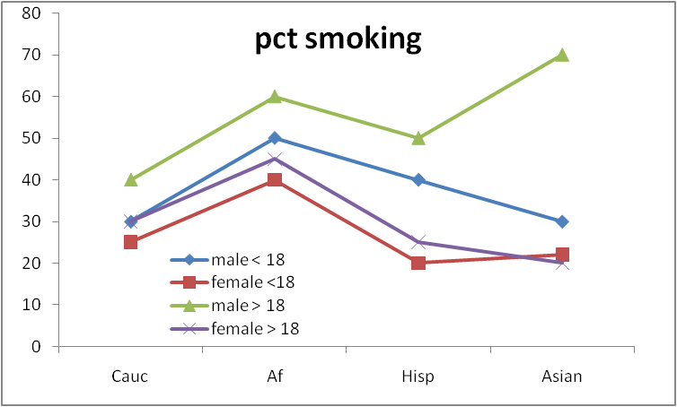
Use line graph
5

Slide 6
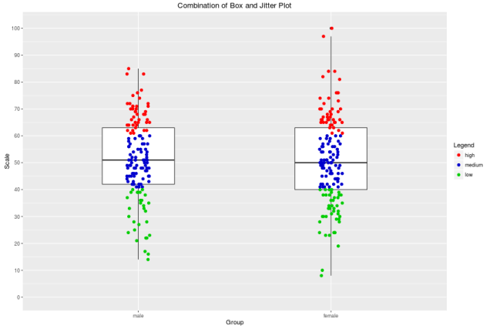
Or (better) use a jitter plot when n is not too big
6

Slide 7

Fundamentals- comparing means

Slide 8

The “Yardstick” is critical

Slide 9
The “Yardstick” is critical
yardstick: _________ 1 µm

Slide 10
The “Yardstick” is critical
yardstick: _________ 10 meters

Slide 11
Weight loss comparison
Diet mean weight loss (lbs) n
Pritikin 5.0 20
UCLA GS 9.0 20
mean difference 4.0
Is 4.0 lbs a “big” difference?
Compared to what? What is the “yardstick”?

Slide 12
The variation yardstick
SD = 1 lb, SE_{diff}=0.32 lb , t=12.6, p value < 0.0001

Slide 13
The variation yardstick
SD = 5 lbs , SE_{diff}=1.58 lb, t= 2.5, p value = 0.02

Slide 14
The SD is the yardstick
It is important that the SD, the “yardstick” be as accurate as possible. It should be based on as much data as possible. If the “yardstick” is not correct, conclusions about which means are different from each other will not be correct.

Slide 15
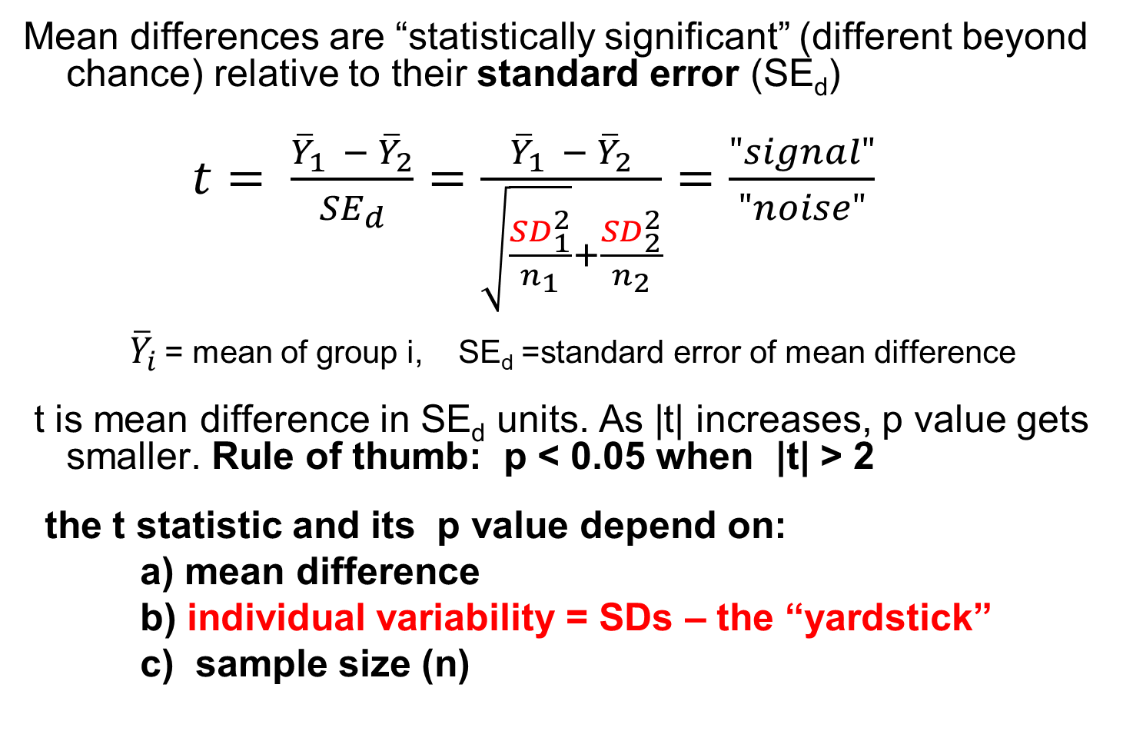
Comparing Means - two groups t test
Mean differences are “statistically significant” (different beyond chance) relative to their standard error (SE_{d})
$t= \frac{{\overline{Y}}_{1 }− {\overline{Y}}_{2}}{{SE}_{d}}=\frac{{\overline{Y}}_{1 }− {\overline{Y}}_{2}}{\sqrt{\frac{{SD}_{1}^{2}}{n_{1}}}+\frac{{SD}_{2}^{2}}{n_{2}}}=\frac{"signal"}{"noise"}$
${\overline{Y}}_{i}$ = mean of group i, SE_{d} =standard error of mean difference
t is mean difference in SE_{d} units. As |t| increases, p value gets smaller. Rule of thumb: p < 0.05 when |t| > 2
the t statistic and its p value depend on:
a) mean difference
b) individual variability = SDs – the “yardstick”
c) sample size (n)

Slide 16
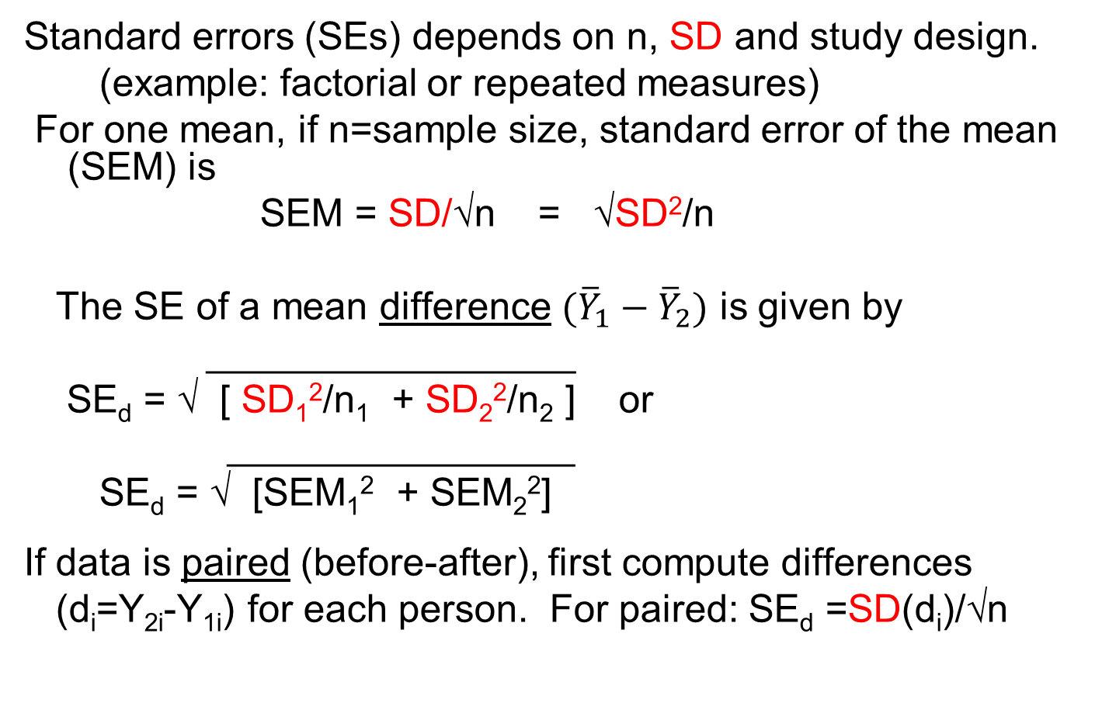
How to compute SE_{d}?
Standard errors (SEs) depends on n, SD and study design.
(example: factorial or repeated measures)
For one mean, if n=sample size, standard error of the mean (SEM) is
SEM = SD/√n = √SD²/n
The SE of a mean difference $({\overline{Y}}_{1}−{\overline{Y}}_{2})$ is given by
_________________
SE_{d} = √ [ SD₁²/n₁ + SD₂²/n₂ ] or
________________
SE_{d} = √ [SEM₁² + SEM₂²]
If data is paired (before-after), first compute differences
(d_{i}=Y_{2i}-Y_{1i}) for each person. For paired: SE_{d} =SD(d_{i})/√n

Slide 17
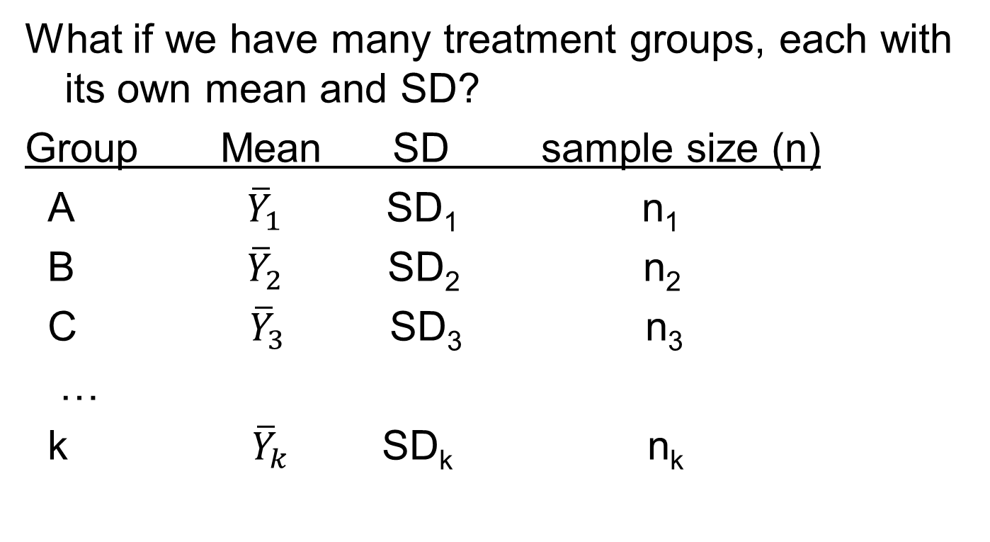
3 or more groups-analysis of variance (ANOVA) Pooled SDs
What if we have many treatment groups, each with its own mean and SD?
Group Mean SD sample size (n)
A ${\overline{Y}}_{1}$ SD₁ n₁
B ${\overline{Y}}_{2}$ SD₂ n₂
C ${\overline{Y}}_{3}$ SD₃ n₃
…
k ${\overline{Y}}_{k}$ SD_{k} n_{k}

Slide 18
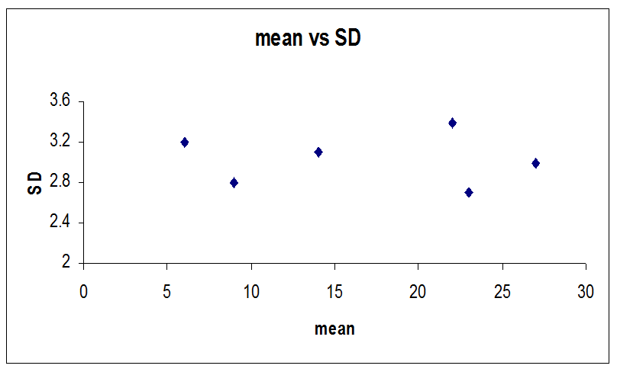
Variance (SD) homogeneity assume one underlying “true” SD assumed true for usual ANOVA

Slide 19
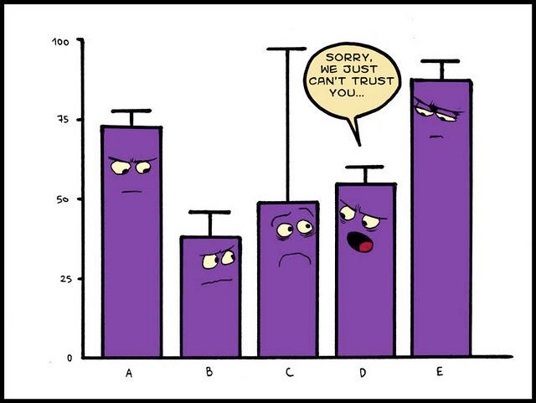
Variance homogeneity

Slide 20
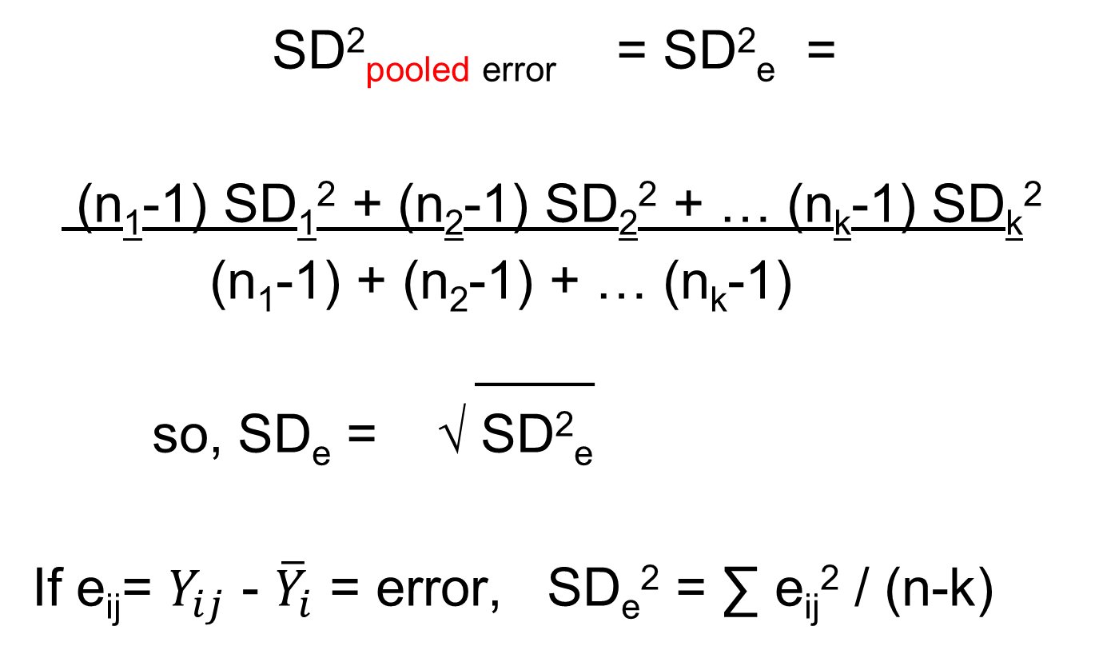
For ANOVA- Pooled SD_{e} the common yardstick
SD²_{pooled error} = SD²_{e} =
(n₁-1) SD₁² + (n₂-1) SD₂² + … (n_{k}-1) SD_{k}²
(n₁-1) + (n₂-1) + … (n_{k}-1)
____
so, SD_{e} = √ SD²_{e}
If e_{ij}= $Y_{ij}$ - ${\overline{Y}}_{i}$ = error, SD_{e}² = ∑ e_{ij}² / (n-k)

Slide 21
ANOVA uses pooled SD_{e} to compute SE_{d} and to compute “post hoc” (post pooling) t statistics and p values.
____________________
SE_{d} = √ [ SD₁²/n₁ + SD₂²/n₂ ]
____________
= SD_{e} √ (1/n₁) + (1/n₂) if using pooled SD_{e}
SD₁ and SD₂ are replaced by SD_{e} a “common yardstick”.
If n₁=n₂=…=n, then SE_{d} = SD_{e}√2/n=constant

Slide 22
t test vs ANOVA – not the same
If there are many groups (A,B,C…) one might compute p values for each comparison via a series of t tests.
group mean n SD SEM
A 20 16 17.0 4.25
B 30 16 14.0 3.50
  C 40 16 12.0 3.00
  Pooled SD = 14.5 , pooled SEM=3.63

Slide 23
t tests vs ANOVA (cont.)
But if we use t tests, we can find that two comparisons with the same mean difference and sample sizes have different p values!
n=16 per group
Comparison mean diff SE_{d} t p value
A vs B 10.0 5.51 1.82 0.091
B vs C 10.0 4.61 2.17 0.048
This is because the “yardstick”, the SD, is changing, so SE_{d} = √SD₁²/n₁+SD₂²/n₂
is changing.

Slide 24
t tests vs ANOVA (cont.)
If one uses the pooled SD, one gets consistent p values for the same mean difference
Pooled SD=14.5, SE_{d}=5.12, n=16 per group
Comparison mean diff SE_{d} t p value
A vs B 10.0 5.12 1.95 0.060
B vs C 10.0 5.12 1.95 0.060
The SE_{d} and t values are all computed using the same SD “yardstick”.

Slide 25
Multiplicity & F tests
Multiple testing can create “false positives”. We incorrectly declare means are “significantly” different as an artifact of doing many tests even if none of the means are truly different from each other.
Imagine we have k=four groups: A, B, C and D.
There are m=six possible mean comparisons:
A vs B
A vs C
A vs D
B vs C
B vs D
C vs D

Slide 26
If we use p < 0.05 as our “significance” criterion, we have a 5% chance of a “false positive” mistake for any one of the m=six comparisons, assuming that none of the groups are really different from each other. We have a 95% chance of no false positives if none of the groups are really different. So, the chance of a “false positive” in any of the six comparisons is
1 – (0.95)⁶ = 0.26 or 26%.

Slide 27
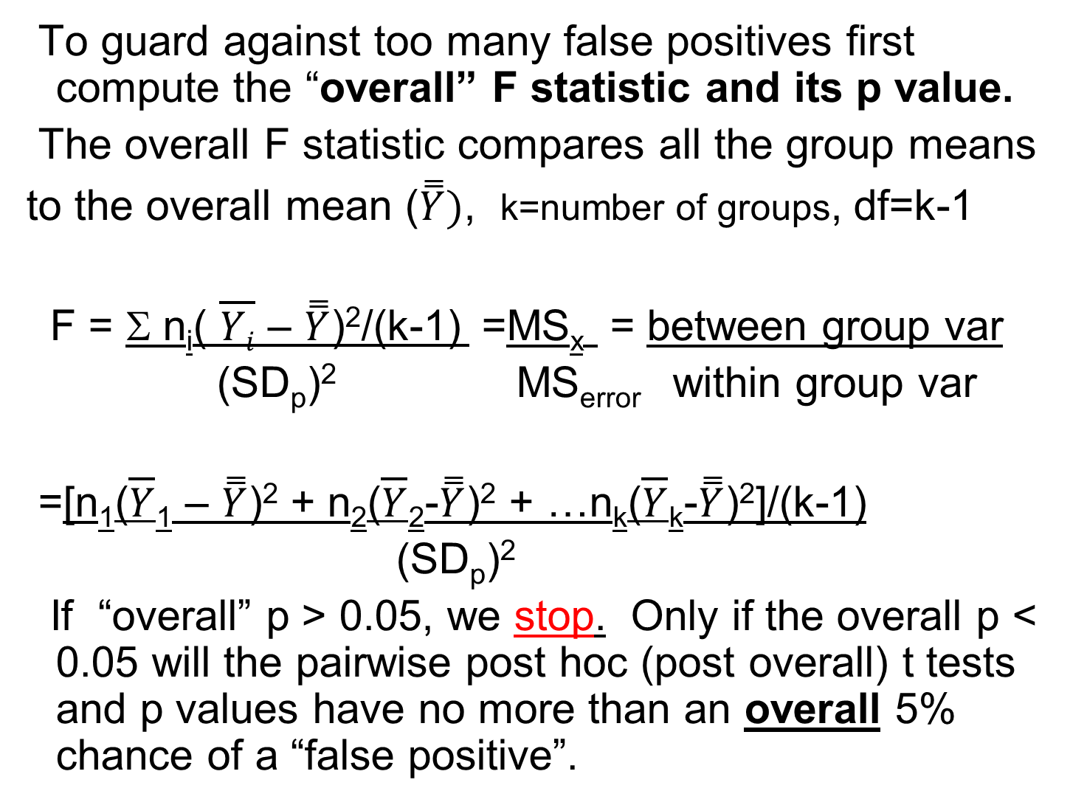
To guard against too many false positives first compute the “overall” F statistic and its p value.
The overall F statistic compares all the group means
to the overall mean ($\overset{̿}{Y})$, k=number of groups, df=k-1
F = Σ n_{i}( $\overline{Yi}$ – $\overset{̿}{Y}$)²/(k-1) =MS_{x} = between group var
(SD_{p})² MS_{error} within group var
=[n₁($\overline{Y}$₁ – $\overset{̿}{Y}$)² + n₂($\overline{Y}$₂-$\overset{̿}{Y}$)² + …n_{k}($\overline{Y}$_{k}-$\overset{̿}{Y}$)²]/(k-1)
(SD_{p})²
If “overall” p > 0.05, we stop. Only if the overall p < 0.05 will the pairwise post hoc (post overall) t tests and p values have no more than an overall 5% chance of a “false positive”.

Slide 28
This criterion was suggested by RA Fisher and is called the Fisher LSD (least significant difference) criterion. It is less conservative (has fewer false negatives) than the very conservative Bonferroni criterion. Bonferroni criterion: if making “m” comparisons, declare significant only if p < 0.05/m.
The F test is an “omnibus” screening test.

Slide 29
Analogy to medical screening test
Imagine testing m=6 subjects for an STD and, in truth, none actually have an STD. If there is a alpha=0.05 “false positive” rate for each test, then the chance of at least one false positive among the six is 1-(0.95)⁶ = 0.265=26.5%.
But, instead of testing all six, we pool samples from all six into one container and test this pool. The combined sample is “positive” (significant) if any of the 6 samples are positive. So, if the pool is negative, there is no need to make the six tests. However, if the pool is positive, one then needs to make the six tests to see which are positive.

Slide 30
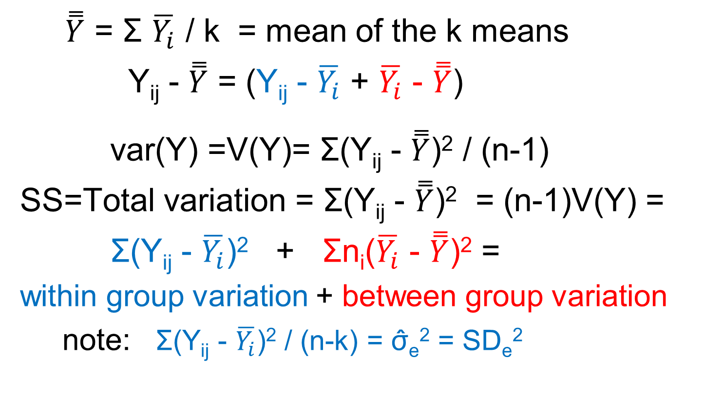
Variance of Y decomposition
$\overset{̿}{Y}$ = Σ $\overline{Y_{i}}$ / k = mean of the k means
Y_{ij} - $\overset{̿}{Y}$ = (Y_{ij} - $\overline{Y_{i}}$ + $\overline{Y_{i}}$ - $\overset{̿}{Y}$)
var(Y) =V(Y)= Σ(Y_{ij} - $\overset{̿}{Y}$)² / (n-1)
SS=Total variation = Σ(Y_{ij} - $\overset{̿}{Y}$)² = (n-1)V(Y) =
Σ(Y_{ij} - $\overline{Y_{i}}$)² + Σn_{i}($\overline{Y_{i}}$ - $\overset{̿}{Y}$)² =
within group variation + between group variation
note: Σ(Y_{ij} - $\overline{Y_{i}}$)² / (n-k) = σ̂_{e}² = SD_{e}²

Slide 31
F statistic interpretation
F is the ratio of between group variation (variation across the means) relative to (pooled) within group variation. This is why this method is called “analysis of variance”
Total variation =
Variation between (among) the means (between group) +
Pooled variation around each mean (within group)
Between group variation
Within group variation
Total variation
F = Between / Within
F ≈ 1 -> not significant
(R²=Between variation/Total variation)

Slide 32
F distribution – under null

Slide 33
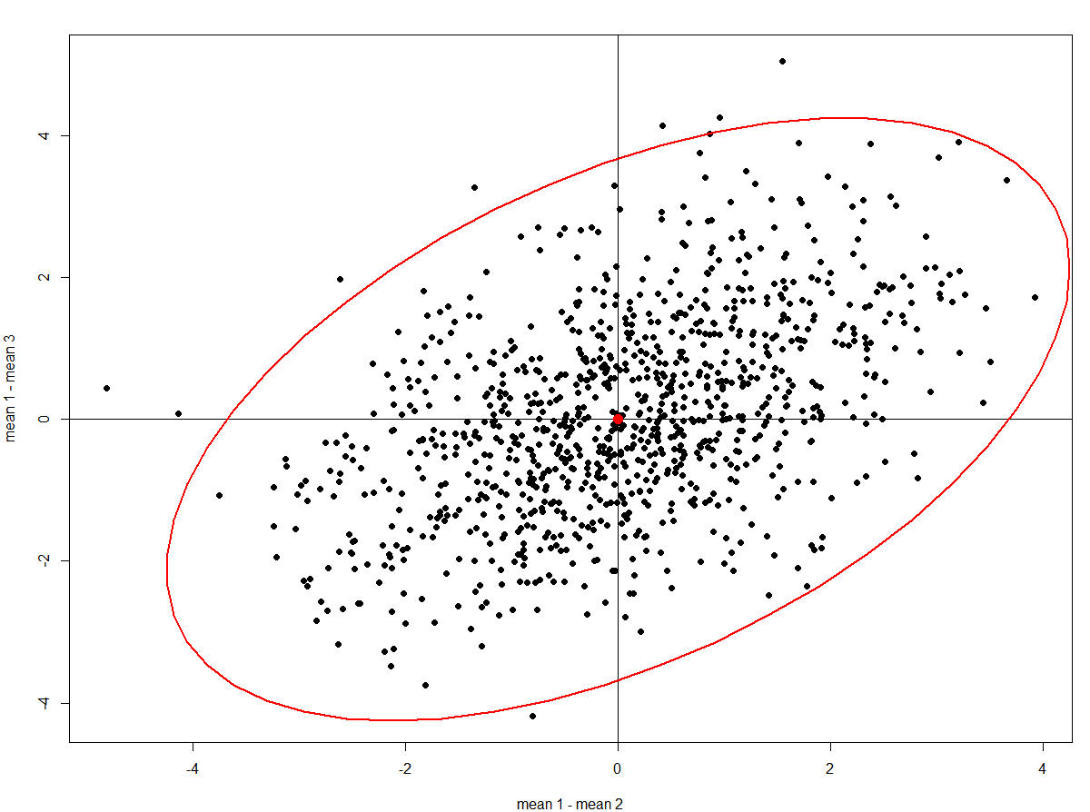
F dist 95% confidence contour, m=2
Each point is a pair of sample mean differences Correlation = 0.50, F=3.004,

Slide 34

TBI expt-time to fall off rotating rod

Slide 35
Ex:Clond-time to fall off rod (sec)

Slide 36
One way analysis of variance time to fall data, k=4 groups, df= k-1=4-1=3
R square | 0.5798
Adj R square | 0.5530
Root Mean Square Error=SD_{e} | 10.99
Mean of Response | 30.20
Observations (or Sum Wgts) | 51
Overall p value
Source | DF | Sum of Squares | Mean Square | F Ratio | Prob > F
group | 3 | 7827.438 | 2609.15 | 21.618 | <.0001
Error | 47 | 5672.546 | 120.69
Total | 50 | 13499.984
SD_{e}²

Slide 37
Means & SDs in seconds
No model
Level | Number | Mean | median | SD | SEM
KO-no TBI | 8 | 21.196 | 21.65 | 6.46 | 2.28
KO-TBI | 7 | 18.659 | 18.47 | 8.73 | 3.30
WT-noTBI | 15 | 49.197 | 46.93 | 9.92 | 2.56
WT-TBI | 21 | 23.902 | 23.33 | 13.31 | 2.90
ANOVA model, pooled SDe=10.986 sec
Level | Number | _{Mean} | SEM
KO-no TBI | 8 | _{21.196} | 3.88
KO-TBI | 7 | _{18.659} | 4.15
WT-noTBI | 15 | _{49.197} | 2.84
WT-TBI | 21 | _{23.902} | 2.40
SEM= SD/√n. Why are no model vs model SEMs not the same?

Slide 38
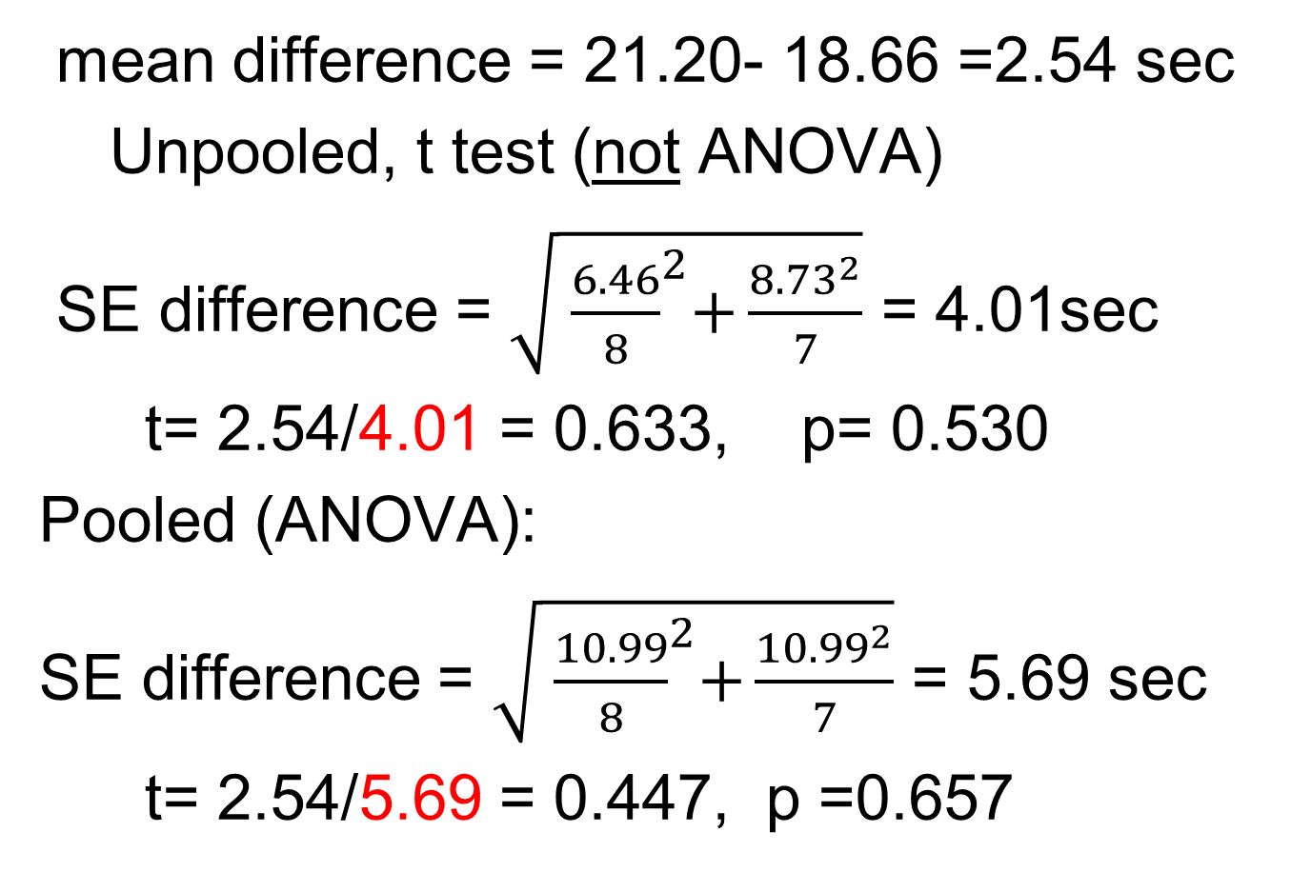
Example: KO-no TBI vs KO-TBI
mean difference = 21.20- 18.66 =2.54 sec
Unpooled, t test (not ANOVA)
SE difference = $\sqrt{{ \frac{6.46}{8}}^{2}+\frac{{8.73}^{2}}{7}}$ = 4.01sec
t= 2.54/4.01 = 0.633, p= 0.530
Pooled (ANOVA):
SE difference = $\sqrt{{ \frac{10.99}{8}}^{2}+\frac{{10.99}^{2}}{7}}$ = 5.69 sec
t= 2.54/5.69 = 0.447, p =0.657

Slide 39
Mean comparisons- post hoc t
Level |  |  |  | Mean
WT-noTBI | A |  |  | 49.197
WT-TBI |  | B |  | 23.902
KO-no TBI |  | B |  | 21.196
KO-TBI |  | B |  | 18.659
Means not connected by the same letter are significantly different

Slide 40
Multiple comparisons-Tukey’s q
As an alternative to Fisher LSD, for pairwise comparisons of “k” means, Tukey computed distribution percentiles for
q=(largest mean-smallest mean)/SE_{d}
under the null hypothesis that all true means are equal. If mean diff/SE_{d} > q is the significance criterion (instead of > t), the type I error is ≤ α for all pairwise comparisons.
q > t > Z q is more strict than t
One looks up mean diff/SE_{d} on the q distribution instead of the t distribution.

Slide 41
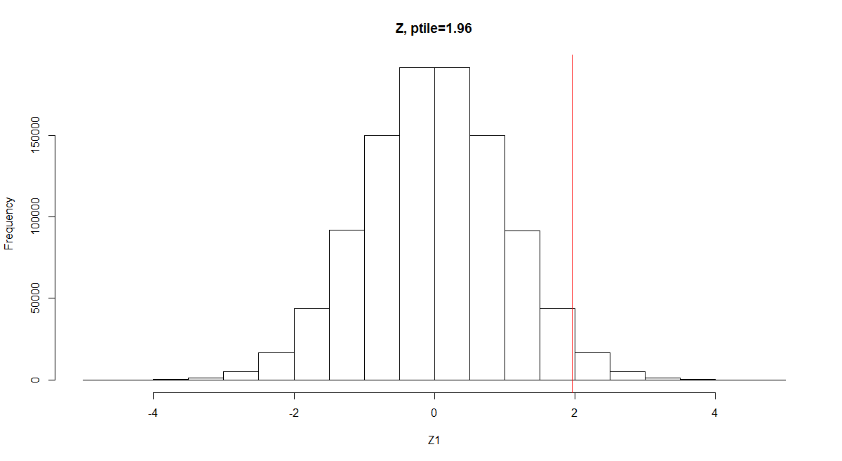
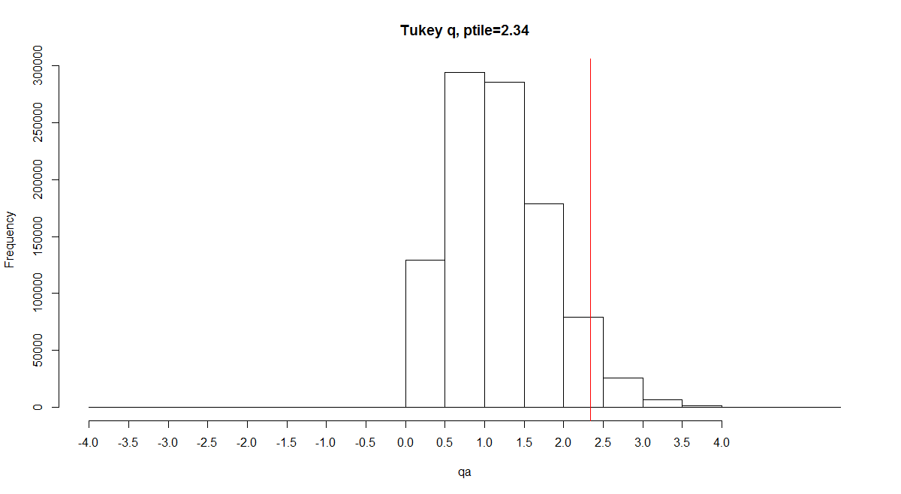
t or Z (unadjusted) vs q (Tukey) – 3 means

Slide 42
t (or Z) vs q percentiles for α=0.05, and large n
num means=k t q*
2 1.96 1.96
3 1.96 2.34
4 1.96 2.59
5 1.96 2.73
6 1.96 2.85
* Some tables give q for SE, not SE_{d}, so must multiply q by √2.

Slide 43
Post hoc: t vs Tukey q, k=4
Level | vs Level | Mean Diff | SE diff | t | p-Value- no correction | p-Value-Tukey
WT-noTBI | KO-TBI | 30.54 | 5.03 | 6.073 | <.0001* | <.0001*
WT-noTBI | KO-no TBI | 28.00 | 4.81 | 5.822 | <.0001* | <.0001*
WT-noTBI | WT-TBI | 25.30 | 3.71 | 6.811 | <.0001* | <.0001*
WT-TBI | KO-TBI | 5.24 | 4.79 | 1.094 | 0.2797 | 0.6952
WT-TBI | KO-no TBI | 2.71 | 4.56 | 0.593 | 0.5562 | 0.9338
KO-no TBI | KO-TBI | 2.54 | 5.69 | 0.446 | 0.6574 | 0.9700

Slide 44
F (circle) vs q (box), k=2, area=0.95
Bivariate normal area above both circle and box= 0.95

Slide 45
Mean comparisons-Tukey
Level |  |  |  | Mean
WT-noTBI | A |  |  | 49.197
WT-TBI |  | B |  | 23.902
KO-no TBI |  | B |  | 21.196
KO-TBI |  | B |  | 18.659
Means not connected by the same letter are significantly different

Slide 46
Transformations
There are two requirements for the analysis of variance (ANOVA) model.
1. Within any treatment group, the mean should be the middle value. That is, the mean should be about the same as the median. When this is true, the data can usually be reasonably modeled by a Gaussian (“normal”) distribution.
2. The SD_{s} should be similar (variance homogeneity) from group to group.
Can plot mean vs median & residual errors to check #1 and mean versus SD to check #2.

Slide 47
Levine test for variance homogeneity
The ratio of any two variances (SD²) from two different groups with sample sizes n₁ and n₂
has an F distribution with df₁=n₁-1 and df₂=n₂-1 under the null hypothesis that the two true variances are the same (H_{o}: σ₁²=σ₂²)
F = SD₁² / SD₂²
Can compare the largest to the smallest SD.
But this test is not robust to outliers.

Slide 48
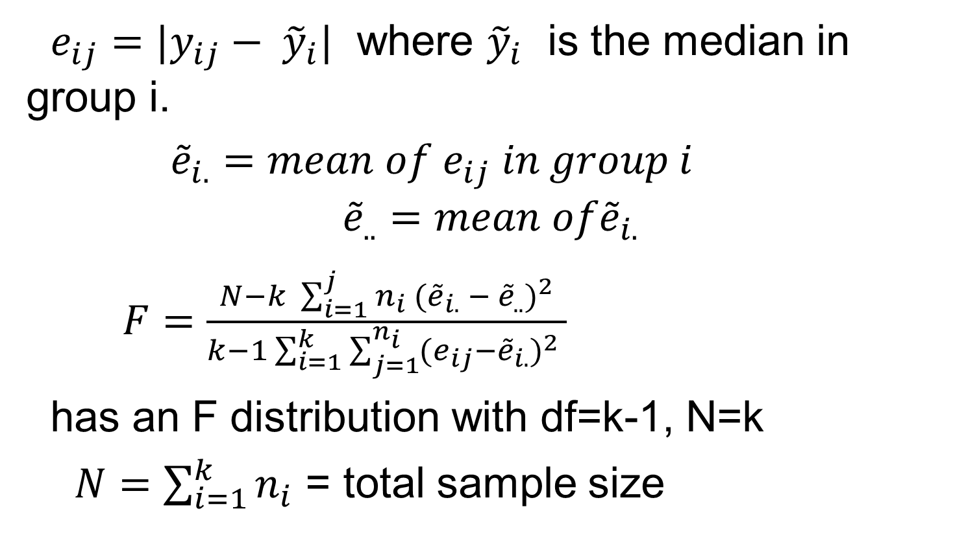
Brown-Forsythe test for variance homogeneity
$e_{ij}=|y_{ij}− {\tilde{y}}_{i}|$ where ${\tilde{y}}_{i}$ is the median in group i.
${\tilde{e}}_{i.}=mean of e_{ij} in group i$
$${\tilde{e}}_{..}=mean of{\tilde{e}}_{i.}$$
$F=\frac{N−k \sum_{i=1}^{j}{n_{i} {({\tilde{e}}_{i.} − {\tilde{e}}_{..})}^{2}}}{k−1\sum_{i=1}^{k}{\sum_{j=1}^{n_{i}}{(e_{ij}}}{−{\tilde{e}}_{i.})}^{2} }$
has an F distribution with df=k-1, N=k
$N=\sum_{i=1}^{k}{n_{i}}$ = total sample size

Slide 49
What if its not true? Two options:
a. Find a transformed scale where it is true.
b. Don’t use the usual ANOVA model (use non constant variance ANOVA models or non parametric models).
Option “a” is better if possible - more power.

Slide 50
Most common transform is log transformation
Usually works for:
1. Radioactive count data
2. Titration data (titers), serial dilution data
3. Cell, bacterial, viral growth, CFUs
4. Steroids & hormones (E2, Testos, …)
5. Power data (decibels, earthquakes)
6. Acidity data (pH), …
7. Cytokines, Liver enzymes (Bilirubin…)
In general, log transform works when a multiplicative phenomena is transformed to an additive phenomena.

Slide 51
Compute stats on the log scale & back transform results to original scale for final report. Since log(A)–log(B) =log(A/B), differences on the log scale correspond to ratios on the original scale. Remember
10 ^{mean(log data)} =geometric mean < arithmetic mean
monotone transformation ladder- try these
Y², Y^{1.5}, Y¹, Y^{0.5}=√Y,
Y⁰=log(Y),
Y^{-0.5}=1/√Y, Y⁻¹=1/Y,Y^{-1.5}, Y⁻²

Slide 52
Multiway ANOVA

Slide 53
Balanced designs - ANOVA example
Brain Weight data, n=7 x 4 = 28, n_{c}=7 obs/cell
Dementia | Sex | Brain Weight (gm)
No | F | 1223
No | F | 1228
No | F | 1222
No | F | 1204
No | F | 1234
No | F | 1211
No | F | 1217
… | … | …

Slide 54
Terminology – cell means, marginal means
 | Males | Females | Overall
Dementia | Cell | Cell | Margin
No dementia | Cell | Cell | Margin
Overall | Margin | Margin

Slide 55
Mean brain weights (gms) in Males and Females with and without dementia
A balanced* 2 x 2 (ANOVA) design,
n_{c}= 7 obs per cell, n=7 x 4 = 28 obs total
Means
Cell mean
Dementia | Males (1) | Female (-1) | Margin
Yes (1) | 1321.14 | 1201.71 | 1261.43
No (-1) | 1333.43 | 1219.86 | 1276.64
Margin | 1327.29 | 1210.79 | 1269.04

Slide 56
Brain weight, n=7 x 4 = 28
Difference in marginal sex means (Male – Female)
1327.29 - 1210.79 = 116.50, 116.50/2 = 58.25
Difference in marginal dementia means (Yes – No)
1261.43 - 1276.64 = -15.21, -15.21/2 = -7.61
Difference in cell mean differences-interaction
(1321.14 - 1333.43) – (1201.71 - 1219.86) = 5.86
(1321.14 - 1201.71) – (1333.43 - 1219.86) = 5.86
note: 5.86/(2x2) = 1.46
Parallel (additive) when interaction is zero
* balanced = same sample size (n_{c}) in every cell

Slide 57
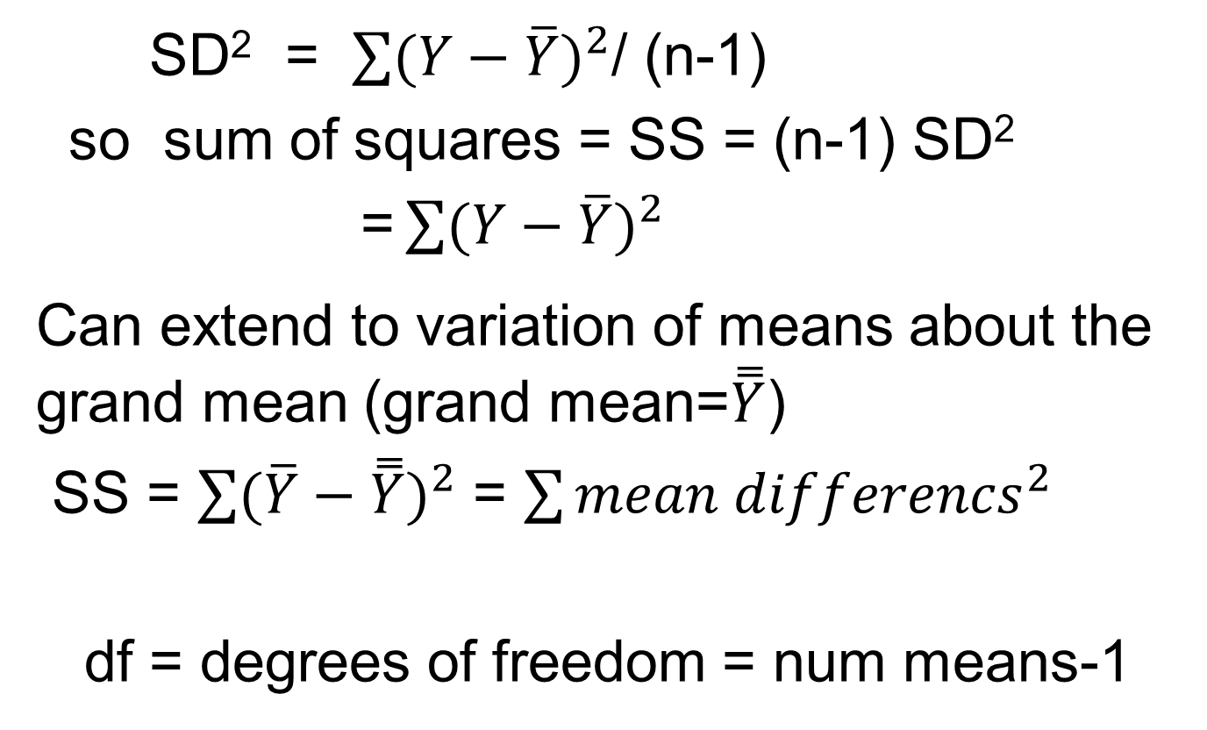
Sum of squares = SS
SD² = $\sum{{(Y−\overline{Y})}^{2}}$/ (n-1)
so sum of squares = SS = (n-1) SD²
= $\sum{{(Y−\overline{Y})}^{2}}$
Can extend to variation of means about the grand mean (grand mean=$\overset{̿}{Y}$)
SS = $\sum{{(\overline{Y}−\overset{̿}{Y})}^{2}}$ = $\sum{{mean differencs}^{2}}$
df = degrees of freedom = num means-1

Slide 58
Brain weight ANOVA table
MODEL: brain wt = sex, dementia , sex*dementia
n=28 observations, n_{c}=7 per cell
Source DF Sum of Squares=SS Mean Square F Value p value
Model 3 96686.11 32228.70 451.05 <.0001
Error 24 1714.80 71.45 = SD²_{e}
C Total 27 98400.91 <- total “information” (total variation in Y)
R-Square Coeff Var Root MSE Mean brain wt R²=Model SS/Total SS
0.9826 0.666092 8.453=SD_{e} 1269.04
ANOVA table – summarizes overall effect of each factor
Source DF SS Mean Square F Value p value
sex 1 95005.75 95005.75 1329.64 <.0001
dementia 1 1620.32 1620.32 22.68 <.0001
sex*dementia 1 60.04 60.04 0.84 0.3685
total 3 96686.11 <- Model SS
Factor SS= n (mean difference)² n=28 F=SS / SD_{e}² =
Sex 58.25² x 28 = 95005.75 signal²/ “noise”²
Dementia 7.61² x 28 = 1620.32
Sex-dementia 1.46² x 28 = 60.04

Slide 59
Mean brain wt vs dementia & sex parallel = no interaction = additive

Slide 60
ANOVA intuition
Mean Y depends on group (A,B,C), sex & their interaction.
Which is significant in each example?
Notes:
Y=mean metZ

Slide 61
ANOVA intuition (cont)
Y=mean metZ

Slide 62
Example: 4 x 2 Design
 | Treatment | Control | Drug margin
Drug A | Cell mean | Cell mean | Marginal mean
Drug B | Cell mean | Cell mean | Marginal mean
Drug C | Cell mean | Cell mean | Marginal mean
Drug D | Cell mean | Cell mean | Marginal mean
 | Marginal mean | Marginal mean | Grand mean

Slide 63
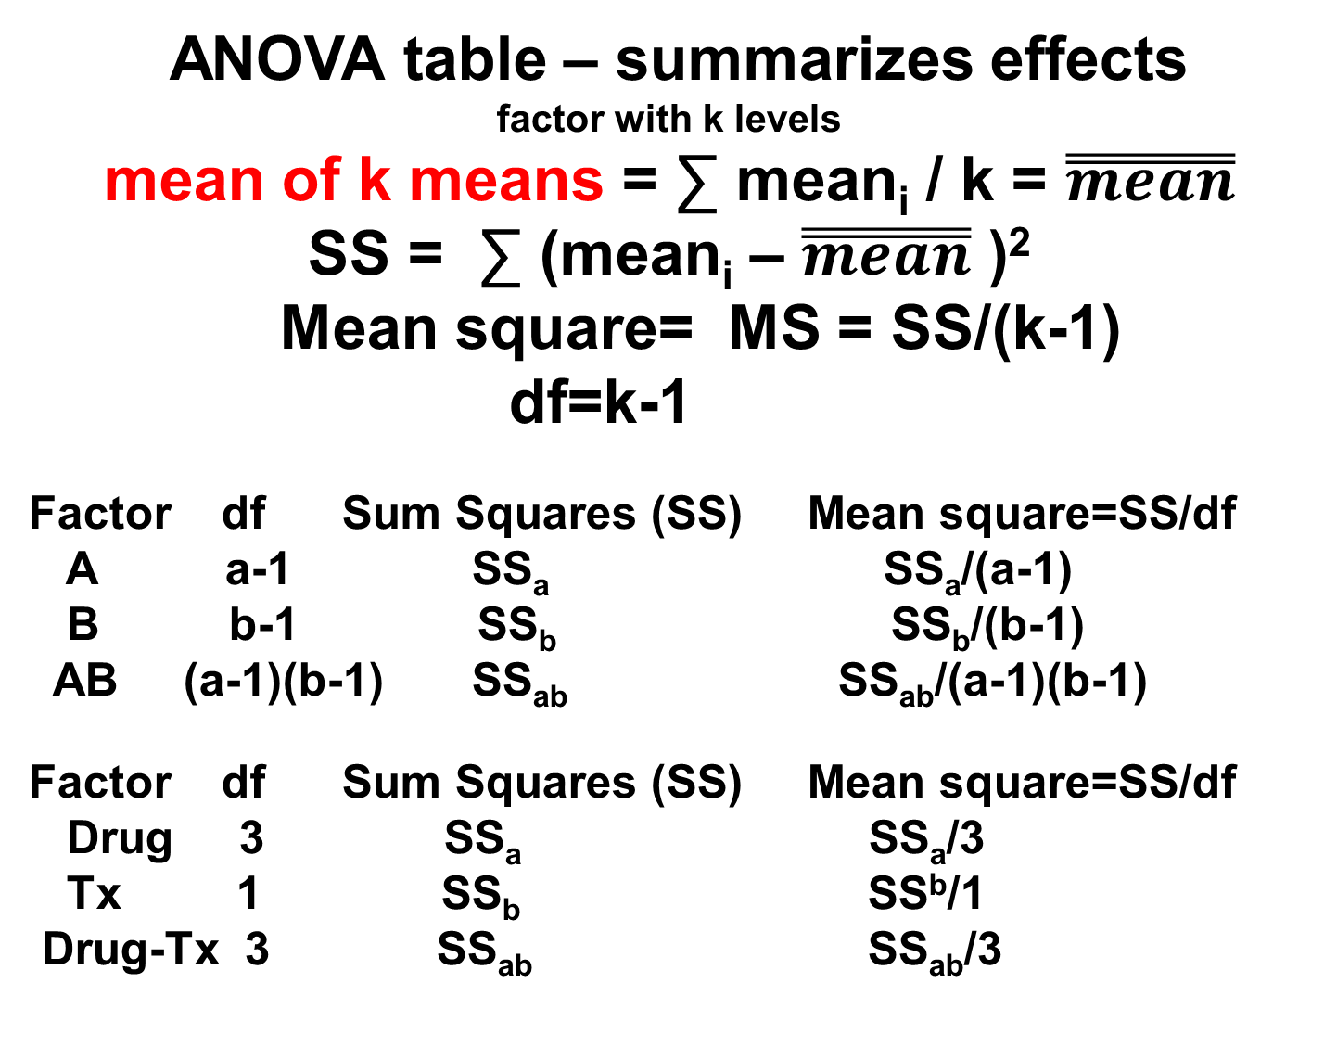
ANOVA table – summarizes effects
factor with k levels
mean of k means = ∑ mean_{i} / k = $\overset{̿}{mean}$
SS = ∑ (mean_{i} – $\overset{̿}{mean}$ )²
Mean square= MS = SS/(k-1)
df=k-1
Factor df Sum Squares (SS) Mean square=SS/df
A a-1 SS_{a} SS_{a}/(a-1)
B b-1 SS_{b} SS_{b}/(b-1)
AB (a-1)(b-1) SS_{ab} SS_{ab}/(a-1)(b-1)
Factor df Sum Squares (SS) Mean square=SS/df
Drug 3 SS_{a} SS_{a}/3
Tx 1 SS_{b} SS^{b}/1
Drug-Tx 3 SS_{ab} SS_{ab}/3

Slide 64
Multiway ANOVA example
Wish to evaluate influence of:
Gender (M or F) – 2 levels
Race/Ethnicity (A, B, H, W) – 4 levels
Education (no HS, HS, BA, MA, PhD) – 5 levels
Occupation (laborer, office worker, manager, scientist, health worker) – 5 levels
on Y = depression score
Y has a normal distribution.
2 x 4 x 5 x 5 = 200 combinations (cells)

Slide 65
Why is the ANOVA table useful?
Dependent Variable: depression score
Source DF SS Mean Square F Value overall p value
Model 199 3387.41 17.02 4.42 <.0001
Error 400 1540.17 3.85
Corrected Total 599 4927.58 root MSE=1.962=SD_{e}, R²=0.687
Source DF SS Mean Square F Value p value
gender 1 778.084 778.084 202.08 <.0001
race 3 229.689 76.563 19.88 <.0001
educ 4 104.838 26.209 6.81 <.0001
occ 4 1531.371 382.843 99.43 <.0001
gender*race 3 1.879 0.626 0.16 0.9215
gender*educ 4 3.575 0.894 0.23 0.9203
gender*occ 4 8.907 2.227 0.58 0.6785
race*educ 12 69.064 5.755 1.49 0.1230
race*occ 12 62.825 5.235 1.36 0.1826
educ*occ 16 60.568 3.786 0.98 0.4743
gender*race*educ 12 77.742 6.479 1.68 0.0682
gender*race*occ 12 59.705 4.975 1.29 0.2202
gender*educ*occ 16 100.920 6.308 1.64 0.0565
race*educ*occ 48 206.880 4.310 1.12 0.2792
gender*race*educ*occ 48 91.368 1.903 0.49 0.9982

Slide 66
8 graphs of 200 depression means.
Y=depr, X=occ (occupation), X=educ.
separate graph for each gender & race
Males Females
W W
B B
H H
A A

Slide 67
One of the 8 graphs
Note parallelism implying no interaction

Slide 68
Evaluating the ANOVA table
Wish to determine which “main effects” and interactions to retain. Start at bottom of table with the highest order (most complicated) interaction (gender*race*educ*occ). If this interaction is not significant, can remove.
Then recalculate p values for remaining terms after interaction removed as the p values can change.
Keep removing until all remaining terms are significant.

Slide 69
Hierarchy rule for interactions
When evaluating interactions, cannot remove “non significant” lower order (simpler) interaction unless corresponding higher order interaction is also not significant and is removed first.
Example: (main effects A, B, C not shown)
Factor p value
A*B 0.7149
A*C 0.0234
B*C 0.4479
A*B*C < 0.0001
Although A*B and B*C are not significant, can’t remove A*B or B*C since A*B*C is significant and contains B.

Slide 70
Depression-final model
Sum of
Source DF Squares Mean Square F overall p
Model 12 2643.981859 220.331822 56.64 <.0001
Error 587 2283.610408 3.89030=SD_{e}²
Corrected Total 599 4927.592267
R-Square Coeff Var Root MSE y Mean
0.536567 21.24713 1.972386=SD_{e} 9.283069
Source DF SS Mean Square F Value p value
gender 1 778.084257 778.08 200.01 <.0001
race 3 229.688698 76.56 19.68 <.0001
educ 4 104.837607 26.21 6.74 <.0001
occ 4 1531.371296 382.84 98.41 <.0001
Analysis shows that factors are additive (no significant interactions)

Slide 71
Marginal means-depression

Slide 72
If one of the factors is NOT significant, the entire set of means for that factor can be collapsed.
The "sum of squares" ANOVA table is a summary table that is useful for screening, particularly screening interactions. It allows one to test "chunks" of the model.
If we also have balance, then all the parts above are orthogonal (uncorrelated) so the assessment of one factor or interaction is not affected if another factor or interaction is significant or not. This is an ideal analysis situation but is not common.

Slide 73
If all of the interaction terms are NOT significant, then one has proven that the influence of all the factors on the outcome Y is additive.
If all the interaction terms for factor “B” are not significant, then the impact of factor B on Y is additive.
Must follow the hierarchical rule: Cannot remove lower order interaction involving factor “B” unless all higher order interactions with B are not significant.

Slide 74
Balanced versus unbalanced ANOVA below “n_{c}=” denotes the sample size in each cell unbalanced since n not same in each cell
Cell and marginal mean amygdala volumes in cc
 | Male | Female | adj marg. mean | Obs marg. mean
Dementia | 0.5 (n_{c}=10) | 0.5 (n_{c}=90) | 0.5 | 0.5 (n=100)
No Dementia | 1.5 (n_{c}=190) | 1.5 (n_{c}=10) | 1.5 | 1.5 (n=200)
Adjusted marg. Means | 1.0 | 1.0
Observed marg. means | 1.45 (n=200) | 0.60 (n=100) |  | n=300
(10 x 0.5 + 190 x 1.5)/200=1.45, (90 x 0.5 + 10 x 1.5)/100=0.60
Gender & dementia NOT orthogonal
Different answer for gender depending on whether one controls for dementia

Slide 75
Repeated measure ANOVA

Slide 76
Repeated measures ignoring vs exploiting correlation
 | Every patient is increasing, corr=r=1
 | patient | time 1 | time 2 | time 3
 | A | 5 | 7 | 10
 | B | 8 | 10 | 13
 | C | 9 | 11 | 14
 | D | 12 | 14 | 17
 | E | 11 | 13 | 16
 | F | 50 | 52 | missing
 | unadjusted mean | 15.8 | 17.8 | 14.0 | <-misleading
 | adjusted mean | 15.8 | 17.8 | 20.8
Patients increase 2 units from time 1 to 2 and increase 3 units from time 2 to 3
Correlation is r=1.0 from one time to another.

Slide 77
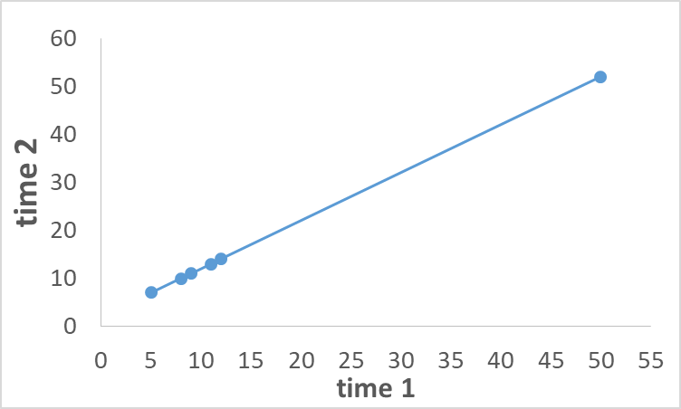
Observations correlated over time
In repeated measure designs, observations on the same subjects are correlated over time. Subjects with low values at time 1 tend to have low values at time 2 and time 3. Subject with high values at time 1 tend to have high values at time 2 and time 3.

Slide 78
Repeated measures
If one computes means only using the observed data, the mean at time 3 is 14.0, lower than the means at time 1 and time 2. But this is misleading since the values are increasing in every patient!
The repeated measure model, in contrast, uses the correlation and change to estimate what the mean would have been at time 3 if the data for patient F had been observed. Under the repeated measure model, the estimated mean is 20.8, not 14. The 20.8 is 3 points higher than 17.8 at time 2, consistent with every patient increasing 3 points from time 2 to time 3 (a perfect correlation in this example).

Slide 79
Repeated measure vs factorial

Slide 80
Means & SEs-factorial vs RM
 |  | Factorial |  |  | Repeated measure
time |  | Mean | SEM |  | mean | SEM
1 |  | 15.83 | 5.867 |  | 15.83 | 4.127
2 |  | 17.83 | 5.867 |  | 17.83 | 4.127
3 |  | 14.00 | 6.427 |  | 20.83 | 4.127
time | vs time |  | Mean Difference | SE diff | p value |  | Mean Difference | SE diff | p value
1 | 2 |  | 2.00 | 8.297 | 0.8130 |  | 2.00 | 0.0238 | <.0001*
1 | 3 |  | 1.83 | 8.702 | 0.8362 |  | 5.00 | 0.0255 | <.0001*
2 | 3 |  | 3.83 | 8.702 | 0.6663 |  | 3.00 | 0.0255 | <.0001*
The factorial mean difference standard errors are MUCH larger since this model is assuming each time has a different group of subjects, not the same subjects measured 3 times. The standard errors of the mean difference are based on the paired differences in the repeated measure model. The correlations are accounted for.

Slide 81
“subject” effect for repeated measures
In addition to the factors of interest, for repeated measure ANOVA, must add a “subject” factor.
For example, if investigating the effect of gender & time on Y, ANOVA table is:
gender - fixed effect
time - fixed effect
gender x time - fixed effect
subject - “random” effect
The factorial ANOVA does not include a “subject” effect. Adding this effect recognizes “correlations” among observations on the same subject as we require the subject effect to be the same on all observations from the same subject.

Slide 82
Factorial vs repeated measure ANOVA
Model Pooled Residual SD²_{e} SD_{e}
Factorial 206.5 14.4
Repeated measure 0.002 0.041
The pooled SD_{e} is too large if the subject effect is not taken into account. If SD_{e} is too large, SEs for the mean differences are too large & their p values are too large.

