Slide 1
Section 10
• Survival analysis
•Competing risks
•Cox proportional hazard regression

Slide 2
Survival curves over time
We know how to compute survival curves if everyone reaches the endpoint so there is no
“censored” data.
Survival at t = S(t) = number still alive at t / n
= 1 – (cum number dead/n)

Slide 3
Stomach cancer survival time in days, n=13
Day | cum dead | cum incidence | survival
0 | 0 | 0.0% | 13/13=100.0%
4 | 1 | 7.7% | 12/13=92.3%
6 | 2 | 15.4% | 11/13=84.6%
8 | 4 (2 dead at t=8) | 30.8% | 9/13=69.2%
12 | 5 | 38.5% | 8/13=61.5%
14 | 6 | 46.2% | 7/13=53.8%
15 | 7 | 53.8% | 6/13=46.2%
17 | 8 | 61.5% | 5/13=38.5%
19 | 9 | 69.2% | 4/13=30.8%
22 | 10 | 76.9% | 3/13=23.1%
24 | 11 | 84.6% | 2/13=15.4%
34 | 12 | 92.3% | 1/13=7.7%
45 | 13 | 100.0% | 0/13= 0.0%

Slide 5
Censoring
We do not always observe the time to the event. For example, if the endpoint is death, we observe some with “t” years of follow up who are (fortunately) still alive. Such an observation is called “censored” (right censored). Censoring is not a “bad” thing. If a subject is still alive at time “t”, their time to death is not completely unknown, it is greater than t. More follow up of course allows for better estimates (higher power, smaller SEs).

Slide 6
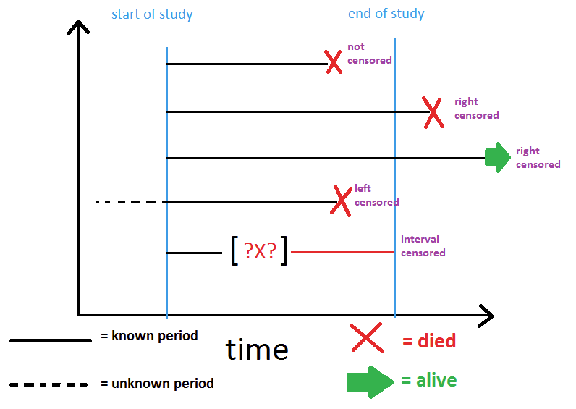
Censoring

Slide 7
Review – joint probability from conditional probability
total n=100
Prob(A and B) = Prob(A ∩ B) = Prob(A│B) Prob(B)
10/100= 10/60 x 60/100
K-M: Prob(alive at time t) =
Prob(alive at t │alive at t-1) Prob(alive at t-1)
where “t-1” is the time before time “t”
50
10
40

Slide 8
Kaplan- Meier curves
Kaplan and Meier (1958) determined how to use censored data to estimate (on average) the survival curve function of time, S(t), one would have obtained if everyone had been followed to the event endpoint - as if there was NO censoring.
K-M formula:
Survival at time t = S(t) =
conditional proportion alive at time t x Survival up to time t
= (1- conditional prop dead at time t) X Survival up to time t
(time prior to time t can be labelled time “t-1”)
That is, survival at time t is conditional on having made it up to time t and the (conditional) outcome (proportion alive or dead) at time t.

Slide 9
K-M numerical example
time=t | n | num dead | num censored | conditional dead | conditional alive | Survival (S) | Cum Incidence
0 | 21 | 0 | 0 | 0.000=0/21 | 1.000=21/21 | 1.000 | 0.000
6 | 21 | 3 | 1 | 0.143=3/21 | 0.857=18/21 | 0.857 | 0.143
7 | 17 | 1 | 1 | 0.059=1/17 | 0.941=16/17 | 0.807 | 0.193
10 | 15 | 1 | 2 | 0.067=1/15 | 0.933=14/15 | 0.753 | 0.247
13 | 12 | 1 | 0 | 0.083=1/12 | 0.917=11/12 | 0.690 | 0.310
16 | 11 | 1 | 3 | 0.091=1/11 | 0.909=10/11 | 0.627 | 0.373
22 | 7 | 1 | 0 | 0.143=1/7 | 0.857=6/7 | 0.538 | 0.462
23 | 6 | 1 | 5 | 0.167=1/6 | 0.833=5/6 | 0.448 | 0.552
total |  | 9 | 12
conditional dead = num dead/n= h, conditional alive = 1- (num dead/n)
Survival at time t = S= conditional alive at time t x survival at previous time
= (1- conditional dead at time t) x survival at previous time
Example: S(t=7) = 16/17 x S(t=6) = (16/17) x 0.857 = 0.807
Cumulative incidence = 1 - Survival
Subject is removed from the “risk set” (denominator=n) for computing conditional dead after subject is censored or dead
hazard rate = 9/305=2.95 dead/100 person-months, median survival ≈ 22.5 months
Notes:
9/21 = 0.428, not same as 0.552

Slide 10
Kaplan-Meier curves survival & cumulative incidence (“risk”)

Slide 11
Comparing two survival curves
Log rank test for p values when comparing two or more survival curves

Slide 12
Comparing curves – log rank test
Since time to event data usually does not follow a normal distribution, one should not summarize the data with means and should not use the t test to compute p values when comparing curves. The non parametric test is the log rank test. For comparing two curves:
χ²_{log rank} = ∑ (dead_{t} – expected dead_{t})² / Variance
Expected num dead in A = (2+10)(10/30)=12(1/3) = 4
The larger the χ² value, the smaller the p value. One entire curve is compared to the other at all time points where events happen. This is not a comparison at only one point in time. (χ² is Z^{2,} df=1)
time | n in A | dead A | n in B | dead B | Expected dead A | Expected dead B
t | 10 | 2 | 20 | 10 | 4 | 8

Slide 13
Variance denominator for log rank test
Variance = Σ n_{At} n_{Bt}(n_{t} – d_{t}) / [ n_{t}²(n_{t}-1) ]
where: n_{it}= num in group “i” at time t
n_{t} = n_{At} + n_{Bt}
d_{t} = dead_{t} = num dead at time t
In previous example (one term in variance):
n_{At}=10, n_{Bt}=20, n_{t}=30, d_{t}=12
Variance_{t} = 10 (20)(30-12)/ [30² 29] = 1.38
Variance = Σ Variance_{t}

Slide 14
Summarizing mortality & other events – hazard rates
Hazard rate = h =
number of persons with outcome
total person-time follow up in all at risk
This is a rate per person-time.
It is NOT a probability (not a “risk”)
In stomach cancer n=13, with 13 deaths, total follow up is
4+6+8+8+12+14+15+17+19+22+24+34+45
= 228 person-days
Hazard rate = mortality rate =
13/228 = 0.057 or 5.7 deaths per 100 person-days of follow up.
Do NOT report as 5.7%-wrong

Slide 15
Hazard rate
h = hazard rate= num events / total follow up time
= events/ Σ t_{i} = event rate (ie death rate)
Number of events excludes those censored.
Denominator of h includes the follow up time of all, censored and non censored.
(1/h=mean time to event only if there is NO censoring.)
In general, h does not have to be constant, h can be a function of time h(t).

Slide 16
Hazard rate ratios & Survival curves
h_{a} = hazard rate in group A h_{b} = hazard rate in group B,
hazard rate ratio, (HR) for A compared to B is
HR = h_{a}/h_{b}
If HR is constant over time one can compute the Survival in group A from the Survival in group B.
S_{a} = S_{b}^{HR}
Ex: HR=0.291, S at t=12 mos is 90% in group B, S=0.90^{0.291} = 0.970 or 97.0% in group A at t=12 months.
A “protective” HR < 1 increases survival. HR >1 decreases survival.

Slide 17
Example: Why hazard rates?
Group n num dead mean f/u total f/u h rate per 1000
A 100 7 36 3600 7/3600=1.94
B 100 2 3 300 2/300 =6.66
Mortality rate is higher for B than A even though the number of persons in each group is the same and more people died in group A.
The hazard rate ratio for A/B is 1.94/6.66=0.291.
When ALL patients are followed to the endpoint, (no censoring) mean time to event= 1/hazard.

Slide 18
Hazard rates & survival curves
log_{e}(S) =cum hazard= -h t, h is (avg) slope of log_{e}(S) vs t

Slide 19
Hazard ratios (HRs) multiply
Similar to odds ratios (ORs), under independence, hazard ratios (HRs) multiply.
Example:
HR for breast cancer recurrence for stage 2 vs stage 1 cancer is HR=8.0, (all else same)
HR for breast cancer recurrence for positive versus negative nodes is HR=1.3.
Then the HR for those who are stage 2 with positive nodes versus stage 1 with negative nodes is 8.0 x 1.3 = 10.4.

Slide 20
Sample HR confidence interval
The statistic b = log_{e}(HR) is better modelled by a normal distribution than HR. The standard error of b is SE(b) = sqrt(1/d₁ + 1/d₂) where d₁ and d₂ are the number of events (such as deaths) in groups 1 and 2.
So, the 95% confidence interval for the true β is [b-1.96 SE, b+1.96 SE]
The 95% confidence interval for HR is the antilog of the these bounds: e^{b-1.96 SE}, e^{b+1.96 SE}

Slide 21
Cumulative hazard rate
log_{e}(S)=Cumulative hazard = Σ_{t} h_{i} = ∫ h(t) dt .
If h is constant over time, then
Cumulative hazard = h T where T is the follow up time. In this case,
h = cum hazard/T
h is the slope of the cum hazard vs t plot.

Slide 22
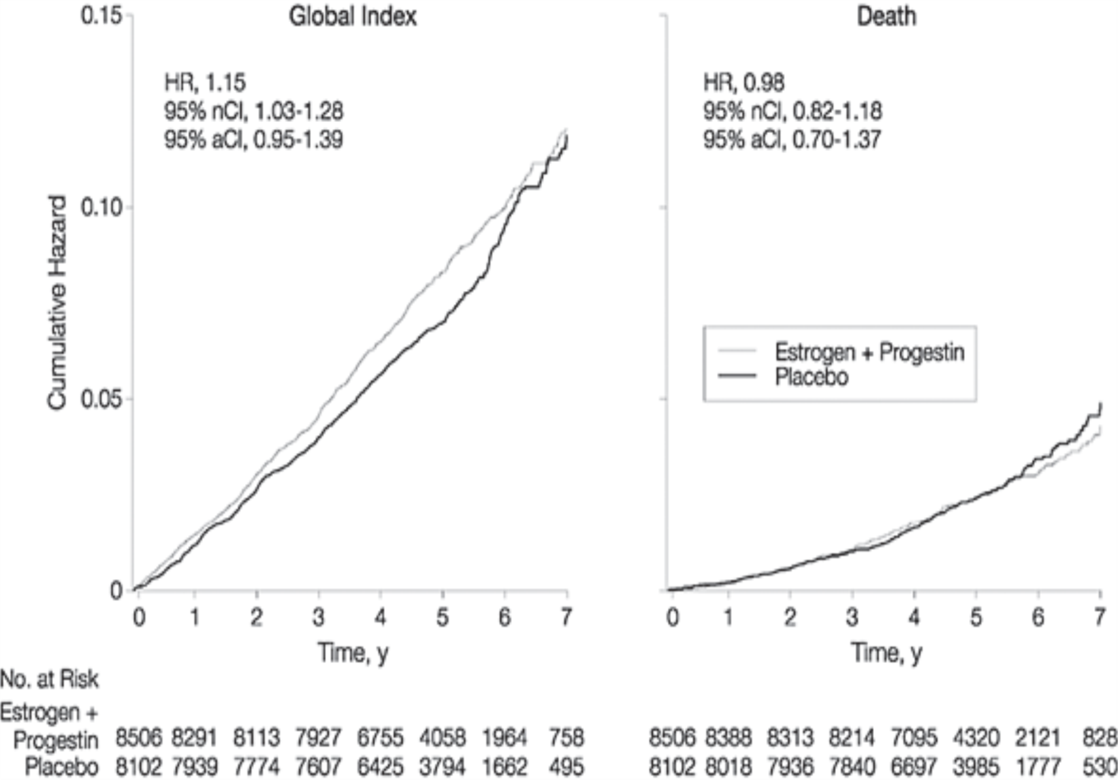
From: Risks and Benefits of Estrogen Plus Progestin in Healthy Postmenopausal Women: Principal Results From the Women's Health Initiative Randomized Controlled Trial - cumulative hazard curves
JAMA. 2002;288(3):321-333.
HR indicates hazard ratio; nCI, nominal confidence interval; andaCI, adjusted confidence interval. Global index = first occurrence of CHD, cancer, stroke, pulmonary embolism, hip fracture or death.

Slide 23
Competing Risks

Slide 24
Competing risks
What if there is more than one time dependent event and a subject is at risk for all of them?
Example: Death from cancer (A), Death from auto accident (B). At any time t, the probability (“risk”) of death from A, death from B or survival (no A, no B) must add to 100%.
Can NOT compute cumulative incidence (risk) for event A by censoring those who had event B and therefore dropping them from those at risk (risk set=n_{j}) at time t.

Slide 25
Competing risk example
time | n | Num dead A | Num dead B | dead A or B | Num censored | conditional dead A | conditional dead B | Survival (S) | Cum Incidence A | Cum Incidence B | ck
0 | 21 | 0 | 0 | 0 | 0 | 0.000 | 0.000 | 1.000 | 0.000 | 0.000 | 1.000
6 | 21 | 2 | 1 | 3 | 1 | 0.095 | 0.048 | 0.857 | 0.095 | 0.048 | 1.000
7 | 17 | 1 | 0 | 1 | 1 | 0.059=1/17 | 0.000 | 0.807 | 0.146 | 0.048 | 1.000
10 | 15 | 0 | 1 | 1 | 2 | 0.000 | 0.067 | 0.753 | 0.146 | 0.101 | 1.000
13 | 12 | 1 | 0 | 1 | 0 | 0.083 | 0.000 | 0.690 | 0.208 | 0.101 | 1.000
16 | 11 | 1 | 0 | 1 | 3 | 0.091 | 0.000 | 0.627 | 0.271 | 0.101 | 1.000
22 | 7 | 0 | 1 | 1 | 0 | 0.000 | 0.143 | 0.538 | 0.271 | 0.191 | 1.000
23 | 6 | 1 | 0 | 1 | 5 | 0.167 | 0.000 | 0.448 | 0.361 | 0.191 | 1.000
total | -- | 6 | 3 | 9 | 12
Conditional dead at time t for A = num dead due to A at time t/ n
Conditional dead at time t for B = num dead due to B at time t / n
Survival = S = (1- conditional dead for A or B at time t) x survival at previous time
(same as K-M survival in previous example)
cumulative death incidence =“new” death incidence at time t + previous cum incidence
Cum incidence A =conditional dead A x survival at previous time + previous cum incidence
Cum incidence B =conditional dead B x survival at previous time + previous cum incidence
Example: Cum incidence of A at t=7 mos = (0.059 x 0.857) + 0.095 = 0.146
check: Survival (S) + cum incidence A + cum incidence B = 1.0 = 100%

Slide 26
Competing risk (incidence) & survival curves

Slide 27
Competing risk (correct) vs censoring the other risk (wrong)
Estimating the cumulative incidence of one event by censoring the other event allows the total incidence of both risks to be more than 100% (wrong). One is estimating one risk as if the other risk did not exist. When there are two types of events (1 and 2), at any given time the incidence of event 1 + the incidence of event 2 + the percent free of both events must add up to 100%.

Slide 28
Example – hours to delivery vaginal vs Cesarean (CS) censoring the other risk is wrong
The cumulative chance of CS or vaginal delivery at time = “∞” cannot both be 100%.

Slide 29
Hours to delivery- competing risks

Slide 30
JMP Survival & competing risks
Survival: Analyze-> Reliability and Survival -> Survival
Fill in “Y, Time to Event”, “Censor”, Grouping (if groups). Enter censor code
Competing risks: Analyze-> Reliability and Survival-> Life Distribution Fill in “Y, Time to Event”, “Censor”, “Failure Cause”, Enter censor code , “Distribution” -> “Manual Pick”
Results are found in :
Individual Causes -> Statistics -> Non parametric Estimates
(not quite same as example above for small n)

Slide 31
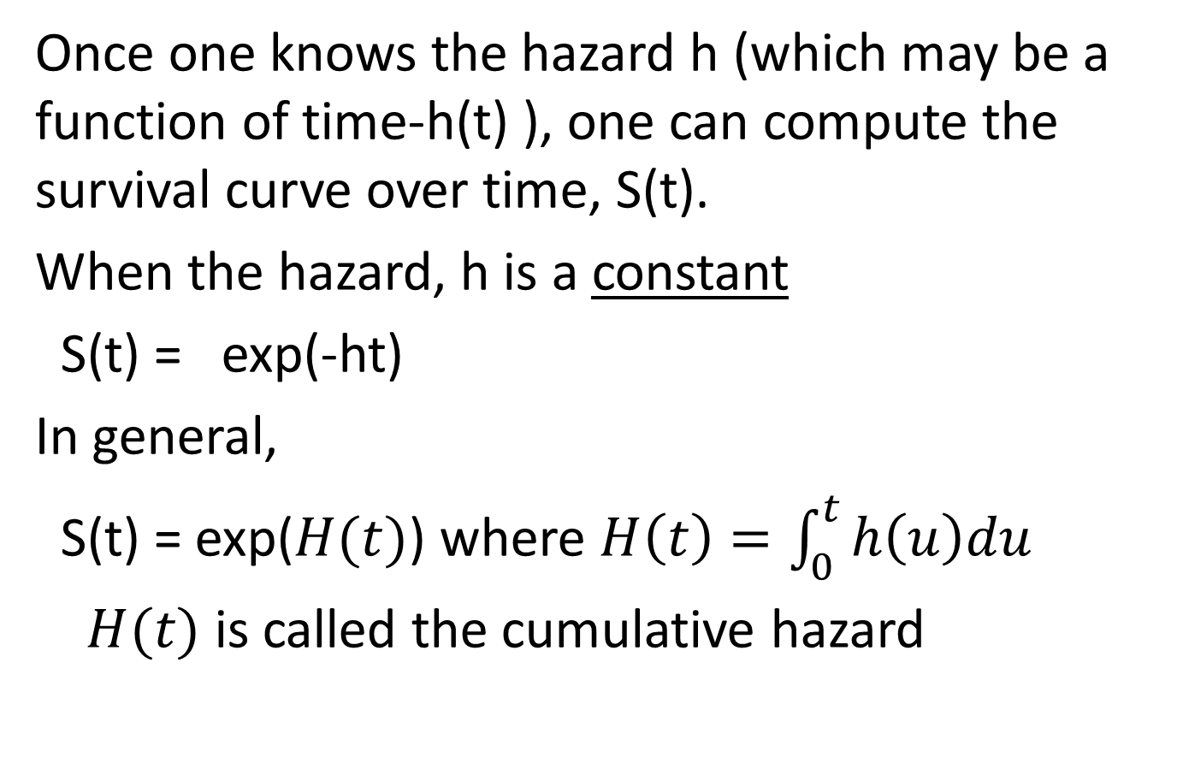
Hazard rate to Survival curve
Once one knows the hazard h (which may be a function of time-h(t) ), one can compute the survival curve over time, S(t).
When the hazard, h is a constant
S(t) = exp(-ht)
In general,
S(t) = exp($H(t)$) where $H\left(t\right)=\int_{0}^{t}{h\left(u\right)du}$
$H(t)$ is called the cumulative hazard

Slide 32
Hazards for competing risks
When there are multiple time dependent endpoints (time to death from cancer, time to death from auto accident), there is a separate hazard rate (or hazard function) for each endpoint. That is, for competing risks, each endpoint has its own hazard, the “cause-specific” hazard.
• hazard for death due to cancer = h(t)_{a}
•hazard for death due to auto accident = h(t)_{b}

Slide 33
Cox (proportional hazard) regression model
May be covered after linear regression

Slide 34
Proportional hazard models
The Cox model is a regression model where the “Y” is the log_{e} of the hazard function, log_{e}(h(t)).
So the regression coefficient (β) for a given predictor variable X is the rate of change of the log hazard per unit increase in X.
The Fine & Gray model is a generalization where there is a separate regression model for each type of event hazard. One does not have to have the same predictor variables (risk factors) for each type of hazard.

Slide 35
Cox model for (log_{e}) h
score= log_{e}(h)=β₀ + β₁ X₁ + β₂ X₂ + ... + β_{k-1}X_{k-1}
h= exp(β₀+ β₁ X₁ + β₂ X₂ + ... + β_{k-1}X_{k-1})
How to interpret the βs ?
Example: X=0 if male, x=1 if female
log(h_{m}) = β₀
log(h_{f}) = β₀ + β₁
log(h_{f}) – log(h_{m}) = log(h_{f}/h_{m}) =β₁
exp(β₁) = h_{f}/h_{m}= hazard rate ratio (HR) for gender, controlling for the other X variables.
Similar to odds ratios in logistic regression

Slide 36
Cox model-interpret HRs (continued)
Model: log_{e}(h)=β₀ + β₁ female + β₂ age
female coded 1=female, 0=male
age is continuous in years
For one year age increase: HR=exp(β₂)
If 30 years old: log_{e}(h₃₀)=β₀ + β₁ female + 30β₂
If 20 years old: log_{e}(h₂₀)=β₀ + β₁ female + 20β₂
log_{e}(h₃₀)-log_{e}(h₂₀)=log_{e}(h₃₀/h₂₀)=30β₂-20β₂ =10β₂
HR =exp(10β₂) = exp(β₂)¹⁰
So HR for 10 year increase is the age HR raised to the 10th power. (Not multiplied by 10)

Slide 37
HRs multiply !
h=rate of breast cancer recurrence
h = exp(β₀ + β₁ X₁ + β₂ X₂)
= exp(β₀) exp(β₁ X₁) exp(β₂ X₂)
(similar to 10²⁺³=10² 10³)
= base hazard x HR₁ x HR₂
Variable beta HR .
positive nodes 1.29 exp(1.29) = 3.63
positive tumor margin 1.15 exp(1.15) = 3.14
What is HR for pos nodes and pos margin vs neither?
3.63 x 3.14 = 11.40

Slide 38
Hazard ratios (HRs) & Survival
S(t) = survival curve (function of t) = S
log(S) = ht= exp(β₀+ β₁ X₁ + β₂ X₂ + ... + β_{k-1}X_{k-1})t
Example: female (X=1) vs male (X=0)
log(S_{f}) = h_{f} t=(e^{β0+β1})t log(S_{m}) = h_{m}t=(e^{β0})t
log(S_{f})/log(S_{m})= h_{f}/h_{m}=e^{β1}=HR
(t cancels out-HR does not depend on t)
log(S_{f}) = HR log(S_{m})
S_{f}(t) = S_{m}(t)^{HR}

Slide 39
Baseline (referent) survival
The “baseline” survival S₀(t), is the overall survival when all variables are at their mean (not when all variables equal zero). So, to compute the survival for any covariate pattern, compute:
HR = h for covariate pattern / baseline h
= exp(log(h) for covariate pattern-base log(h))
= exp(raw risk score – mean raw risk score)
The base log h= β₀.
S(t) = S₀(t)^{HR}
Notes:
Example: surv-lung ca

Slide 40
Chung Overall survival (“at mean”)

Slide 41
Example: Breast Cancer recur/death
(Chung) n=86 of 95, 23 failures, C=0.84
Predictor | beta | SE | Haz Rate Ratio | Lower CL | Upper CL | p value
Pre-Menopausal (vs post) | 0.750 | 0.552 | 2.12 | 0.72 | 6.25 | 0.1853
Positive nodes (yes or no) | 1.29 | 0.52 | 3.63 | 1.29 | 10.28 | 0.0152
Stage 2 vs 1 | 2.12 | 0.70 | 8.30 | 2.11 | 32.59 | 0.0007
Stage 3 vs 1 | 0.98 | 0.95 | 2.67 | 0.42 | 17.07 | 0.3063
Stage 4 vs 1 | 3.85 | 0.91 | 46.83 | 7.94 | 276.3 | < 0.001
Positive tumor margin | 1.15 | 0.51 | 3.14 | 1.15 | 8.59 | 0.0350
Neoadjuvant chemo | -1.61 | 0.84 | 0.20 | 0.04 | 1.04 | 0.0483

Slide 42
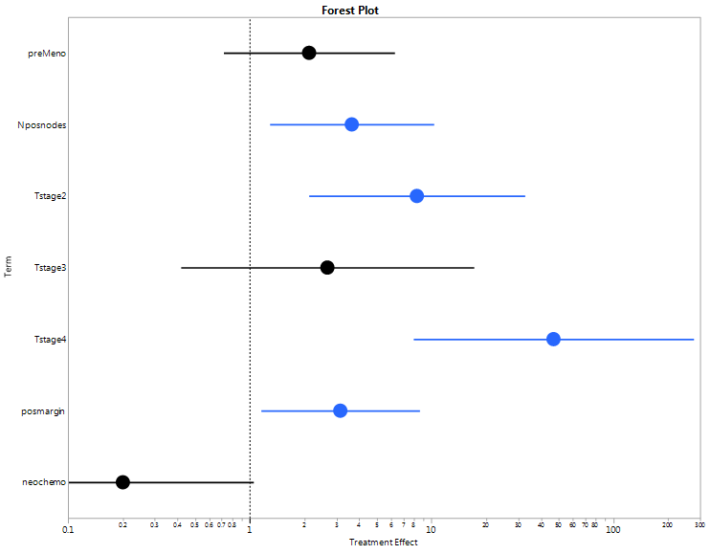
Forest plot- Chung model

Slide 43
“Risk” calculator- risk score
Coding:
PreMen= 1 if pre menopausal, 0 if post
PosNode = 1 if positive nodes, 0 if negative
Stage = dummy coded with stage 1 as reference
PTM = positive tumor margin, 1 if pos, 0 if neg
NeoAdj = neoadjuvant chemo, 1 if yes, 0 if no
Raw Risk score = Raw RS = 0.75 PreMen + 1.29 PosNode + 2.12 stage2 + 0.98 stage3+3.85 stage 4 +1.15 PTM -1.61 NeoAdj

Slide 44
Risk calculator (cont.)
Centered risk score = Centered RS = Raw RS – β₀
where β₀ = raw risk score evaluated at the mean of all the predictors. This makes the centered risk score equal to zero when all predictors are at their mean.
Centered risk score = 0.75 PreMen + 1.29 PosNode + 2.12 stage2 + 0.98 stage3+3.85 stage 4 +1.15 PTM -1.61 NeoAdj -2.084

Slide 45
Risk calculator (cont)
HR = exp(centered RS)
When centered RS=0, HR= 1. The referent group is the group at the overall mean for all predictors.
S(t) = S(t)₀^{HR}
where S(t)₀ is the overall survival curve at time t. When centered RS=0, S(t)=S(t)₀.

Slide 46
Cox Model performance
Harrel’s C statistic – similar to C statistic in ROC analysis or logistic regression is a measure of model accuracy. Can plot C versus time since C is not necessarily constant. Harrel’s C is an “average” value over all time. 0.50 < C < 1.0
In those failed before t or followed to time t-make all possible pairs of true failure – true non failure. True failure should have higher risk score (concordant).
(Also need to verify the proportional hazard assumption- not covered in class).
True non fail | True failure
Low risk score | High risk score

Slide 47
Plot C versus time see if accuracy is constant over time

Slide 48

Model performance-survival curves by score quartiles
(Chung model, C=0.84)
Red= lowest score
Orange=highest score
Survival curves across different score quartiles should be very different

Slide 49
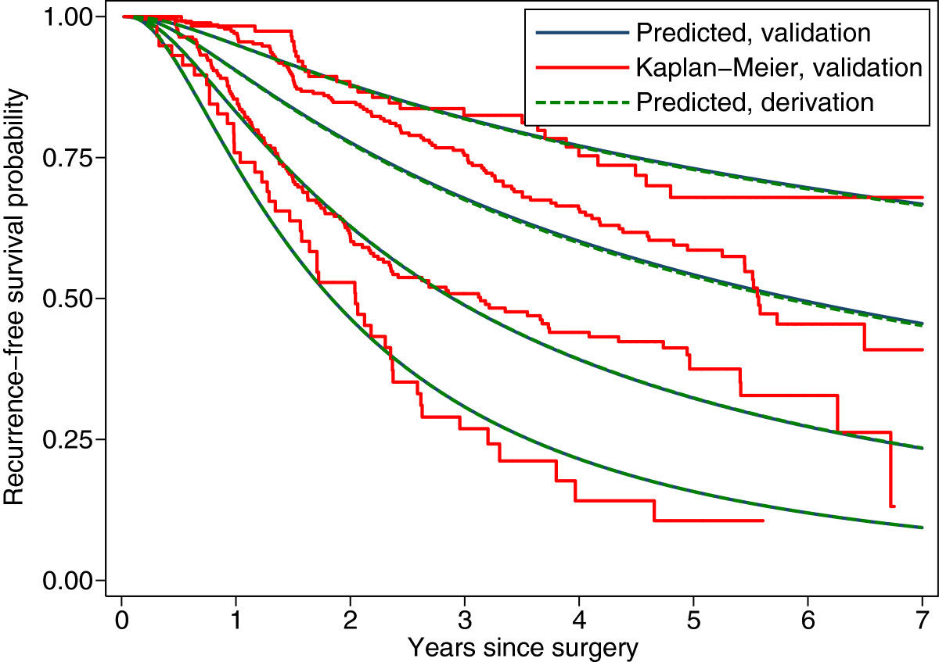
model vs empirical survival curves by quantiles

